Slide 1

Computers
Week 1
LBSC 690
Information Technology

Slide 2
Goals
By the end of this class, you will…
  Know what’s in a computer
  Understand what makes stupid computers seem smart
  Have ways to think about “space,” “time” and “speed”

Slide 3
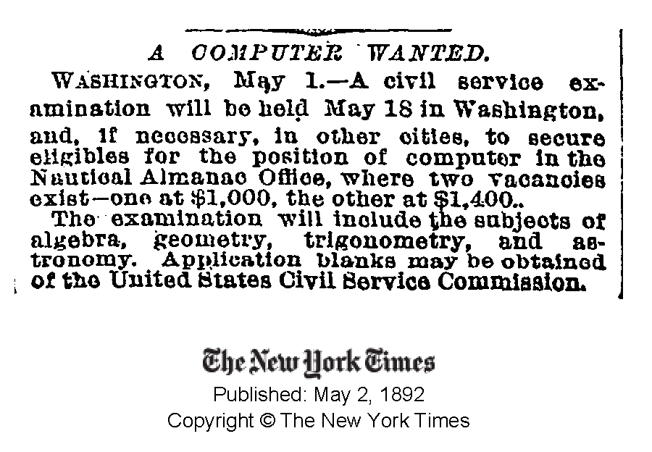

Slide 4
A Very Brief History of Computing
Hardware
  Mechanical: essentially a big adding machine
  Analog: designed for calculus, limited accuracy
  Digital: early machines filled a room
  Microchips: designed for missile guidance
Software
  Numeric: computing gun angles
  Symbolic: code-breaking

Slide 5
Commercial Developments
Mainframes (1960’s)
  IBM
Minicomputers(1970’s)
  DEC
Personal computers (1980’s)
  Apple, Microsoft
Networks (1990’s)
  Web
Convergence (2000’s)
  Cell phone/PDA, HDTV/Computer, …

Slide 6
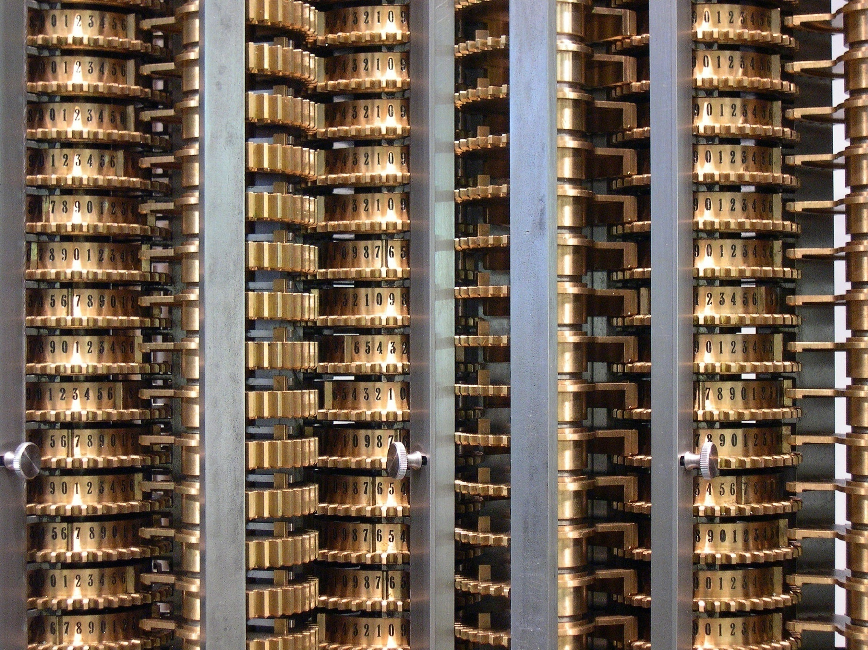
Source: Wikipedia

Slide 7
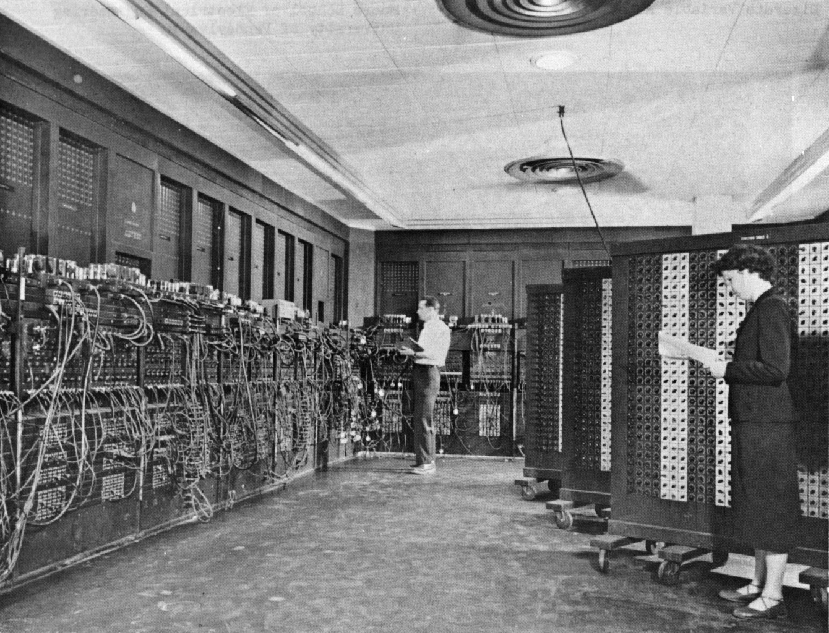
Source: Wikipedia

Slide 8
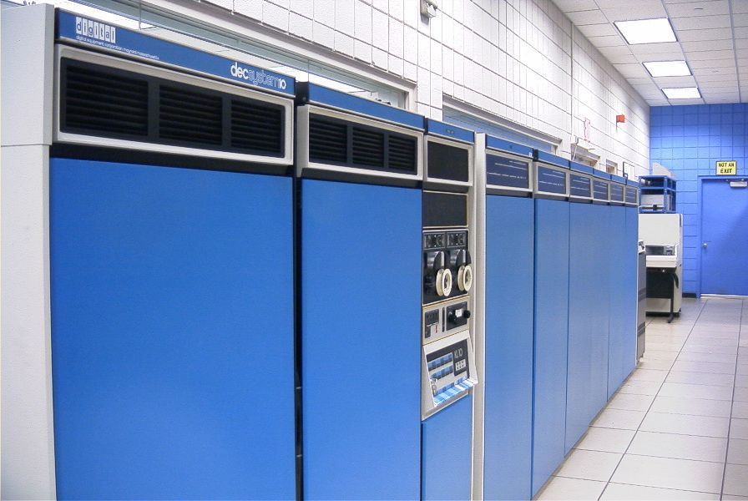
Source: Wikipedia

Slide 9
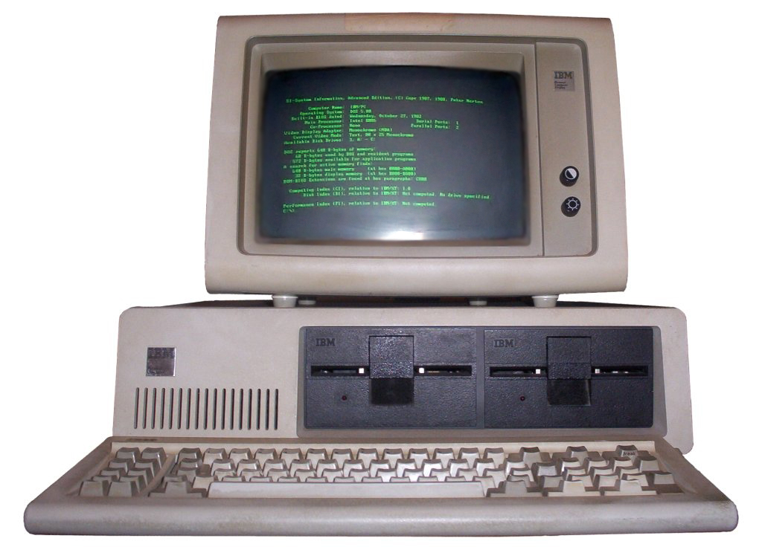
Source: Wikipedia

Slide 10

Source: Wikipedia

Slide 11
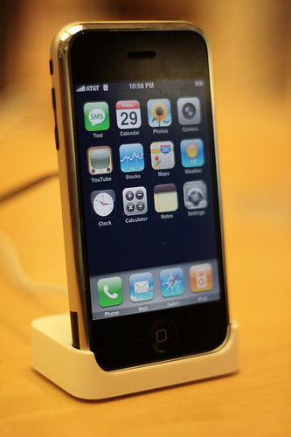
Source: Wikipedia

Slide 12
The Big Picture
Memory
Processor
Network

Slide 13
Binary Data Representation
Example: American Standard Code for Information Interchange (ASCII)
01000001 = A
01000010 = B
01000011 = C
01000100 = D
01000101 = E
01000110 = F
01000111 = G
01001000 = H
01001001 = I
01001010 = J
01001011 = K
01001100 = L
01001101 = M
01001110 = N
01001111 = O
01010000 = P
01010001 = Q
…
01100001 = a
01100010 = b
01100011 = c
01100100 = d
01100101 = e
01100110 = f
01100111 = g
01101000 = h
01101001 = i
01101010 = j
01101011 = k
01101100 = l
01101101 = m
01101110 = n
01101111 = o
01110000 = p
01110001 = q
…

Slide 14
Hardware Processing Cycle
Input comes from somewhere
  Keyboard, mouse, microphone, camera, …
The system does something with it
  Processor, memory, software, network, …
Output goes somewhere
  Monitor, speaker, robot controls, …

Slide 15
What is a computer?
Memory
Processor
Output
Input

Slide 16
Computer Hardware
Central Processing Unit (CPU)
  Intel Xeon, Motorola Power PC, …
Communications “Bus”
  FSB, PCI, ISA, USB, Firewire, …
Storage devices
  Cache, RAM, hard drive, floppy disk, …
External communications
  Modem, Ethernet, GPRS, 802.11, …

Slide 17
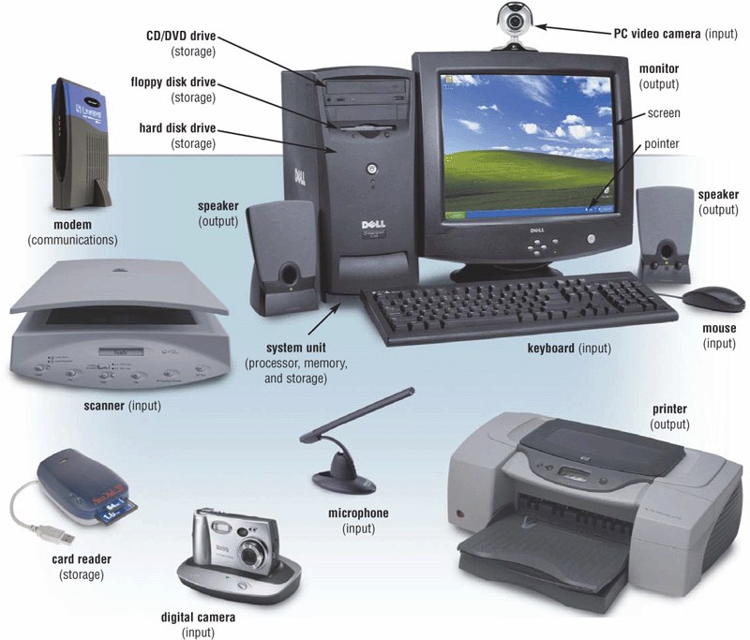
Extracted From Shelly Cashman Vermatt’s Discovering Computers 2004

Slide 18
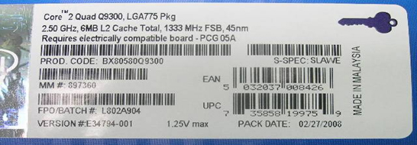
What’s that?

Slide 19
Units of Frequency
Unit | Abbreviation | Operations per second
hertz | Hz | 1
kilohertz | KHz | 10³ = 1,000
megahertz | MHz | 10⁶ = 1,000,000
gigahertz | GHz | 10⁹ = 1,000,000,000

Slide 20
Units of Time
Unit | Abbreviation | Duration (seconds)
second | sec/s | 1
millisecond | ms | 10⁻³ = 1/1,000
microsecond | μs | 10⁻⁶ = 1/1,000,000
nanosecond | ns | 10⁻⁹ = 1/1,000,000,000
picosecond | ps | 10⁻¹² = 1/1,000,000,000,000
femtosecond | fs | 10⁻¹⁵ = 1/1,000,000,000,000,000

Slide 21
The Storage Hierarchy
Speed, cost, and size:
  You can easily get any 2, but not all 3
Fast memory is expensive
  So large memory is slow!
  But fast access to large memories is needed
Solution:
  Keep what you need often in small (fast) places
    Keep the rest in large (slow) places
  Get things to the fast place before you need them

Slide 22
Best of Both Worlds
Small, but fast…
=
+
Is Large and seems fast
Large, but slow…
Think about your bookshelf and the library…

Slide 23
Locality
Spatial locality:
  If the system fetched x, it is likely to fetch data located near x
Temporal locality:
  If the system fetched x, it is likely to fetch x again

Slide 24
System Architecture
Keyboard
Mouse
Sound
Card
Video
Card
Input
Controller
System Bus
Front Side Bus
Hard
Drive
CD/
DVD
L2
RAM
USB Port
CPU
L1
Cache
Motherboard

Slide 25
Everything is Relative
The CPU is the fastest part of a computer
  3 GHz Core 2 Duo = 6,000 MIPS
    3 operations per processor every nanosecond
Cache memory is fast enough to keep up
  128 kB L1 cache on chip (dedicated, CPU speed)
  4 MB L2 cache on chip (shared, CPU speed)
RAM is larger, but slower
  1 GB or more, ~6 ns

Slide 26
Units of Size
Unit | Abbreviation | Size (bytes)
bit | b | 1/8
byte | B | 1
kilobyte | KB | 2¹⁰ = 1024
megabyte | MB | 2²⁰ = 1,048,576
gigabyte | GB | 2³⁰ = 1,073,741,824
terabyte | TB | 2⁴⁰ = 1,099,511,627,776
petabyte | PB | 2⁵⁰ = 1,125,899,906,842,624

Slide 27
The Storage Hierarchy
Type | Speed | Size | Cost
Registers | ~300 ps | 256 B | Very expensive
Cache | ~1 ns | 4 MB | Expensive
RAM | ~10 ns | 1 GB | Cheap
Hard drive | ~10 ms | 1 TB | Very cheap

Slide 28
“Solid-State” Memory
ROM
  Does not require power to retain content
  Used for “Basic Input/Output System” (BIOS)
Cache (Fast low-power “Static” RAM)
  Level 1 (L1) cache: small, single-purpose
  Level 2 (L2) cache: larger, shared
(“Dynamic”) RAM (Slower, power hungry)
  Reached over the “Front-Side Bus” (FSB)
Flash memory (fast read, slow write EEPROM)
  Reached over USB bus or SD socket
  Used in memory sticks (“non-volatile” storage)

Slide 29
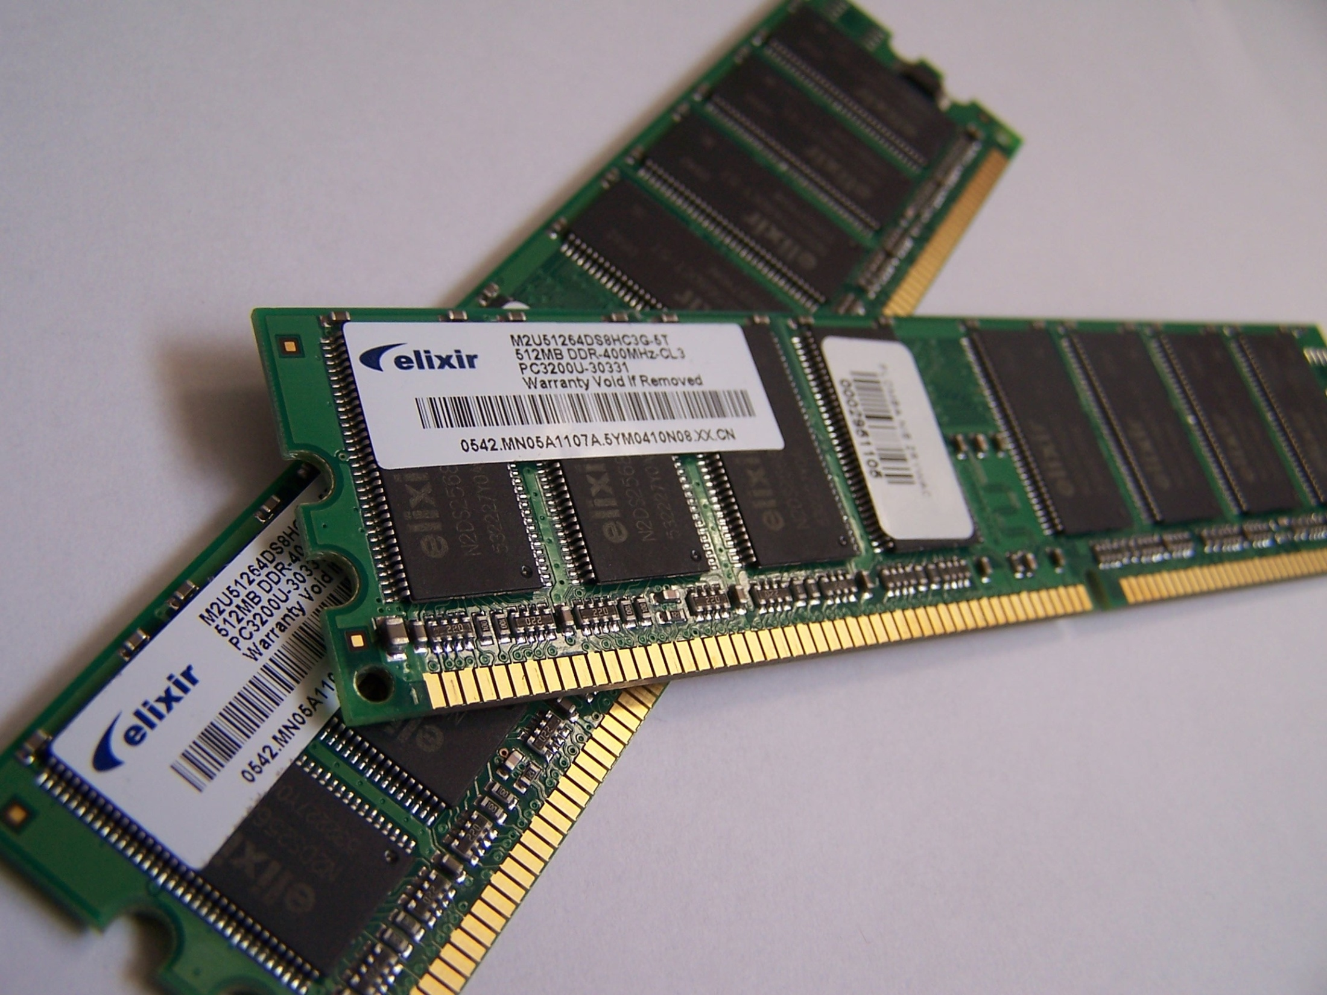
Source: Wikipedia

Slide 30
“Rotating” Memory
Fixed magnetic disk (“hard drive”)
  May be partitioned into multiple volumes
    In Windows, referred to as C:, D:, E:, …
    In Unix, referred to as /software, /homes, /mail, …
Removable magnetic disk
  Floppy disk, zip drives, …
Removal optical disk
  CDROM, DVD, CD-R, CD-RW, DVD+RW, …

Slide 31
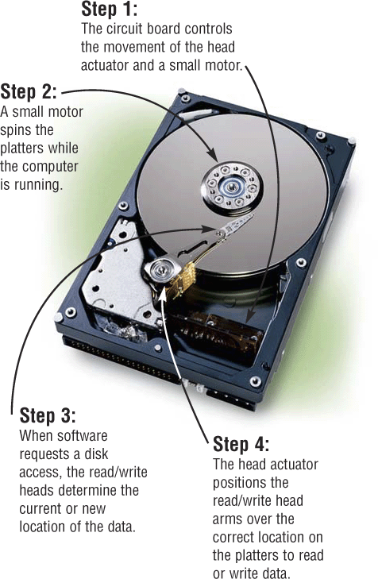
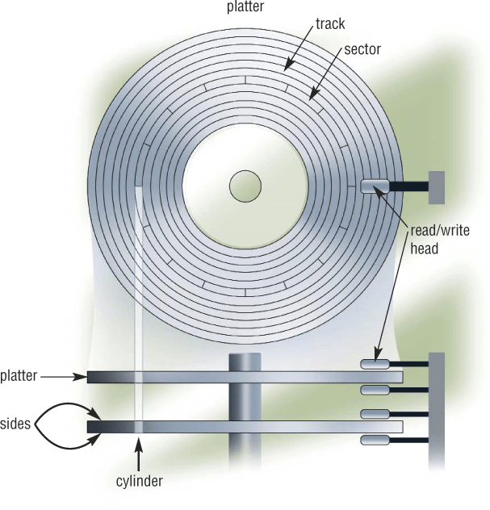
How Disks Work
Extracted From Shelly Cashman Vermatt’s Discovering Computers 2004

Slide 32
Trading Speed for Space
Hard disk is larger than RAM but much slower
  typical: 10 ms access time, 100 GB (at 5400 rpm)
    One thousand times larger than RAM
    10 million times slower than the CPU!
The initial access is the slow part
  Subsequent bytes sent at 17 MB/sec (60 ns/byte)
As “virtual memory,” makes RAM seem larger
  But too little physical RAM results in “thrashing”

Slide 33
Breaks
Typically, two breaks
  10 minute break after the first hour
  5 minute break after the second hour

Slide 34
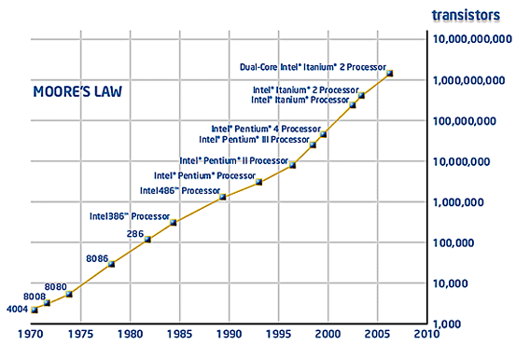

Slide 35
Discussion Point: Moore’s Law
Processing speed doubles every 18 months
  Faster CPU, longer words, larger cache, more cores
Cost/bit for RAM drops 50% every 12 months
  Less need for “virtual memory”
Cost/bit for disk drops 50% every 12 months
  But transfer rates don’t improve much
Why????

Slide 36
Parallel Processing
More “cores” (CPU’s) = more computation

Slide 37
Parallel Storage
Disks can fail in two ways:
  Bad sectors (data sectors, directory sectors)
  Mechanical failure
RAID-5 arrays “stripe” blocks across disks
  Faster parallel data transfer
  ~30% “parity” allows “hot swap”
    Continuity of operations in the event of a disk failure
    Automatic reconstruction of any one failed disk’s contents

Slide 38
Tape Backup
Tapes store data sequentially
  Very fast transfer, but not “random access”
Used as backup storage for fixed disks
  Weekly incremental backup is a good idea
    With a complete (“level zero”) monthly backup
Used for archival storage
  Higher data density than DVD’s

Slide 39
Discussion Point: Migration
What format should old tapes be converted to?
  Newer tape
  CD
  DVD
How often must we “refresh” these media?
How can we afford this?

Slide 40
Course Goals
Conceptual
  Understand computers and networks
  Appreciate the effects of design tradeoffs
  Evaluate the role of information technology
Practical
  Learn to use some common tools
  Solve a practical problem
  Develop a personal plan for further study

Slide 41
Some Motivating Questions
What are the technical implications for:
  Privacy?
  Copyright?
How will digital repositories develop?
  How will they interact with distance education?
  What are the implications for archives?
How might digital interaction impact:
  Roles of authors, publishers, and readers?
  Access by disadvantaged populations?

Slide 42
Some iSchool Courses on IT
LBSC
  607: E-Government
  683: Electronic Records
  708X: E-Discovery
  784: Digital Preservation
INFM
  741: Social Computing
  743: Internet Applications
INST
  630: Programming
  631: HCI Fundamentals
  733: Database Design
  715: Knowledge Management
  734: Information Retrieval
  736: Computational Linguistics
  737: Digging into Data

Slide 43
Instructional Staff
Professor: Dr. Doug Oard
  Offices: HBK 2119F/AVW 3145
  Email: oard@umd.edu (finds me anywhere)

Slide 44
Approach
Readings
  Provide background and detail
“Socratic” sessions
  Provide conceptual structure
“Practicum” sessions, homework, project
  Provide hands-on experience
Quiz, exams
  Measure progress

Slide 45
The Grand Plan
Computers
Databases
Networks
Access/SQL
Web Design
Search Engines
HTML/CSS
Programming
Quiz
CMS
ILS/DAMS
Midterm
Joomla
Info Mngmt
Project
Info Mngmt
Final

Slide 46
A Personal Approach to Learning
Work ahead, so that you are never behind
Find new questions everywhere
  Then find the answers somewhere
Enrich your practical skills relentlessly
Pick topics you want to learn more about
Start thinking about your project soon
  Find partners with complementary skills

Slide 47
Getting From Here to There
What you need to know
Midterm
Quiz
Nobody does this!
What I did in Grad School
What you know now

Slide 48
Grading
35-38% individual work
  Exams: 25% for the best, 10% for the other
12-15% your choice (individual or group)
  3% each for best 5 of the 6 homework/quiz
40% working in 3-person project teams
10% for demonstrated thought leadership
  In class, on the mailing list, in your groups

Slide 49
Some Observations on Grading
One exam is worth more than all the homework
  Message: Use the homework to learn the material
Midterm grades predict final grades well
  Message: Develop sound study skills early
You need not be good at everything to get an A
  But you do need to be excellent at several things

Slide 50
The Fine Print
Group work is encouraged on homework
  But you must personally write what you turn in
Deadlines are firm and sharp
  Allowances for individual circumstances are included in the grading computation
Academic integrity is a serious matter
  No group work during the exams or the quiz!
  Scrupulously respect time limits

Slide 51
Course Materials
Textbook
Readings
Videos
Daily access to a networked computer!

Slide 52
Computing at Maryland
Computer Labs
  HBK 2018 (posted hours)
  PG2 Open Workstation Lab (24 hours)
  Need an OIT “LPCR” account for printing
WAM
  Web server and Web space

Slide 53
Homework Goals
Think about relative speed and relative size
Interpret specifications for computer systems
Try some “back of the envelope” calculations
Some helpful hints:
  Use a spreadsheet!

Slide 54
Team Exercise
Form into groups of 4
  Be sure you have someone who has used Excel before in your group
Answer question 1(d) from the Fall 1996 final exam (available on the course Web site)

Slide 55
Before You Go
On a sheet of paper, answer the following (ungraded) question (no names, please):
What was the muddiest point in today’s class?

Slide 56
Get-Ahead Slides

Slide 57
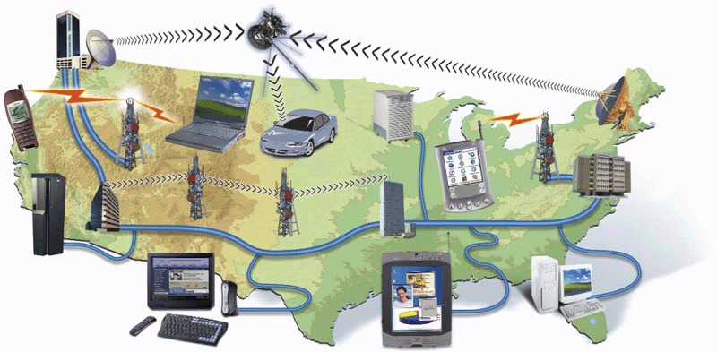
Network
Computers and devices connected via
  Communication devices
  Transmission media

Slide 58
Why Network?
Sharing data
Sharing information
Sharing hardware
Sharing software
Increasing robustness
Facilitating communications
Facilitating commerce

Slide 59
Packet vs. Circuit Networks
Telephone system (“circuit-switched”)
  Fixed connection between caller and called
  High network load results in busy signals
Internet (“packet-switched”)
  Each transmission is routed separately
  High network load results in long delays

Slide 60
Packet Switching
Break long messages into short “packets”
  Keeps one user from hogging a line
Route each packet separately
  Number them for easy reconstruction
Request retransmission for lost packets
  Unless the first packet is lost!

Slide 61
Networks of Networks
Local Area Networks (LAN)
  Connections within a room, or perhaps a building
Wide Area Networks (WAN)
  Provide connections between LANs
Internet
  Collection of WANs across multiple organizations

Slide 62
Local Area Networks
Within a campus or an office complex
  Short-distance lines are fast and cheap
  Fast communications makes routing simple
Ethernet is a common LAN technology
  All computers are connected to the same cable
    Ordinary phone lines can carry 10 Mb/sec
    100 Mb/s connections require special cables
    1 Gb/s connections require special switches
  Every host broadcasts everything to all others
    Collisions limit throughput to about 50% utilization

Slide 63
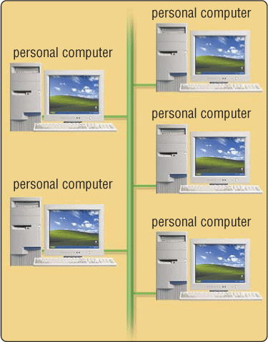
Shared Network
All attach to the same cable
  Ethernet and “cable modems”
Transmit anytime
  Collision detection
  Automatic retransmission
Inexpensive and flexible
  Easy to add new machines
  Robust to computer failure
Practical for short distances
  Half the bandwidth is wasted

Slide 64
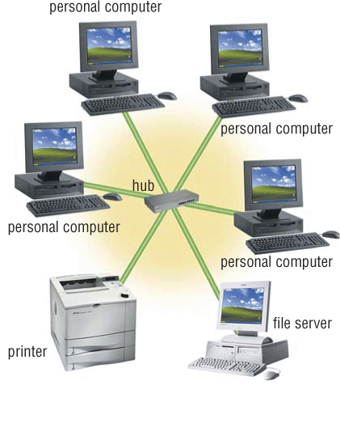
Switched (“Star”) Network
All attach directly to a hub
  Switched Ethernet
  Digital Subscriber Lines (DSL)
Higher cost
  Line from hub to each machine
  Hub must handle every packet
  Hub requires backup power
Much higher bandwidth
  No sharing, no collisions
  Allows disks to be centralized

Slide 65
Local Area Networks
CSS
www
rac2
rac3
rac4
ttclass
PLS
sam
kim
ann
dove
joe
HBK

Slide 66
Wireless Networks
Radio-based Ethernet
  Effective for a few rooms within buildings
“Access Point” gateways to wired networks
  Available throughout most of the Maryland campus
  Commercial providers offer “hot spots” in airports, etc.
“WiFi WLAN” is available in several speeds
  IEEE 802.11b: 10Mb/s (good enough for most uses)
  IEEE 802.11g: 54Mb/s (required for wireless video)
  IEEE 802.11n: 248Mb/s (and longer range)
Computer-to-computer networks are also possible
  “Bluetooth” is the most common (very short range)

Slide 67
Wide Area Networks
Campus, regional, national, or global scale
Expensive communications must be used well
  Limiting to two hosts allows 100% utilization
Routing is complex with point-to-point circuits
  Which path is shortest? Which is least busy? …

Slide 68
Maryland’s Campus Network
Elsewhere in CSS
www
rac2
rac3
rac4
ttclass
CSS 1410
sam
kim
ann
dove
joe
HBK

Slide 69
The Internet
Global collection of public “IP” networks
  Private networks are often called “intranets”
Independent
  Each organization maintains its own network
Cooperating
  Internet Protocol (IP) address blocks
  Domain names
  World-Wide Web Consortium (W3C)
  Computer Emergency Response Team (CERT)

Slide 70
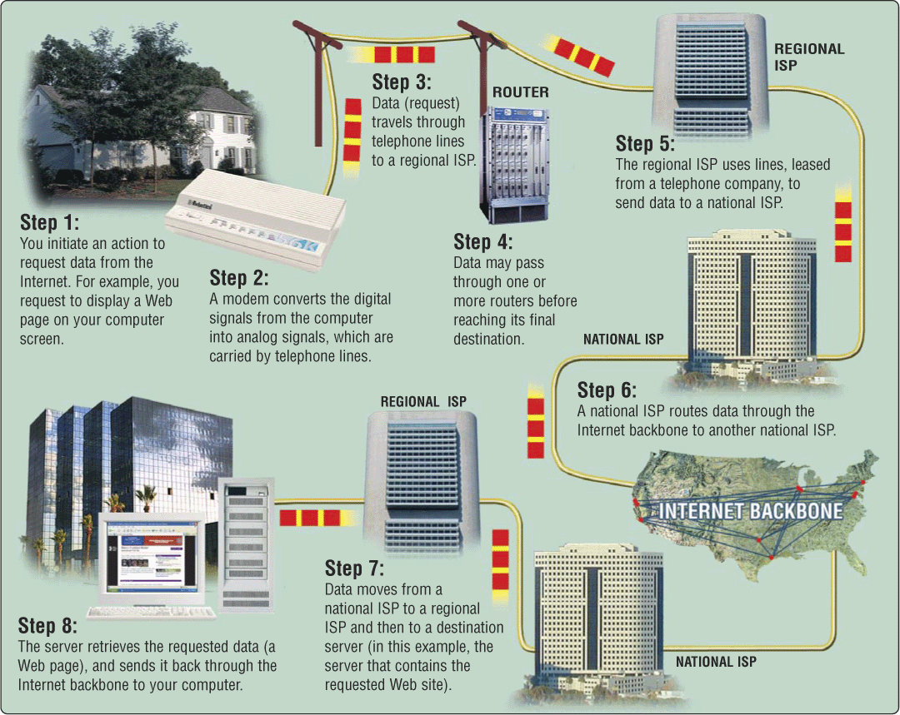
Overview

Slide 71
A Short History of the Internet
1969: Origins in government research
  Advanced Research Projects Agency (ARPAnet)
  Key standards: UDP, TCP, DNS
1983: Design adopted by other agencies
  Created a need for inter-network connections
  Key standards: IP
1991: World-Wide Web added point-and-click
  Now 150 million Internet “hosts”
  Key standards: HTTP, URL, HTML, XML
Notes:
Moore’s law make shift from large time sharing computer facilities to individual, small but powerful computer systems, and

Slide 72
Internet ≠ Web
Internet: collection of global networks
Web: way of managing information exchange
  More details on this next week
There are many other uses for the Internet
  File transfer (FTP)
  Email (SMTP, POP, IMAP)

Slide 73
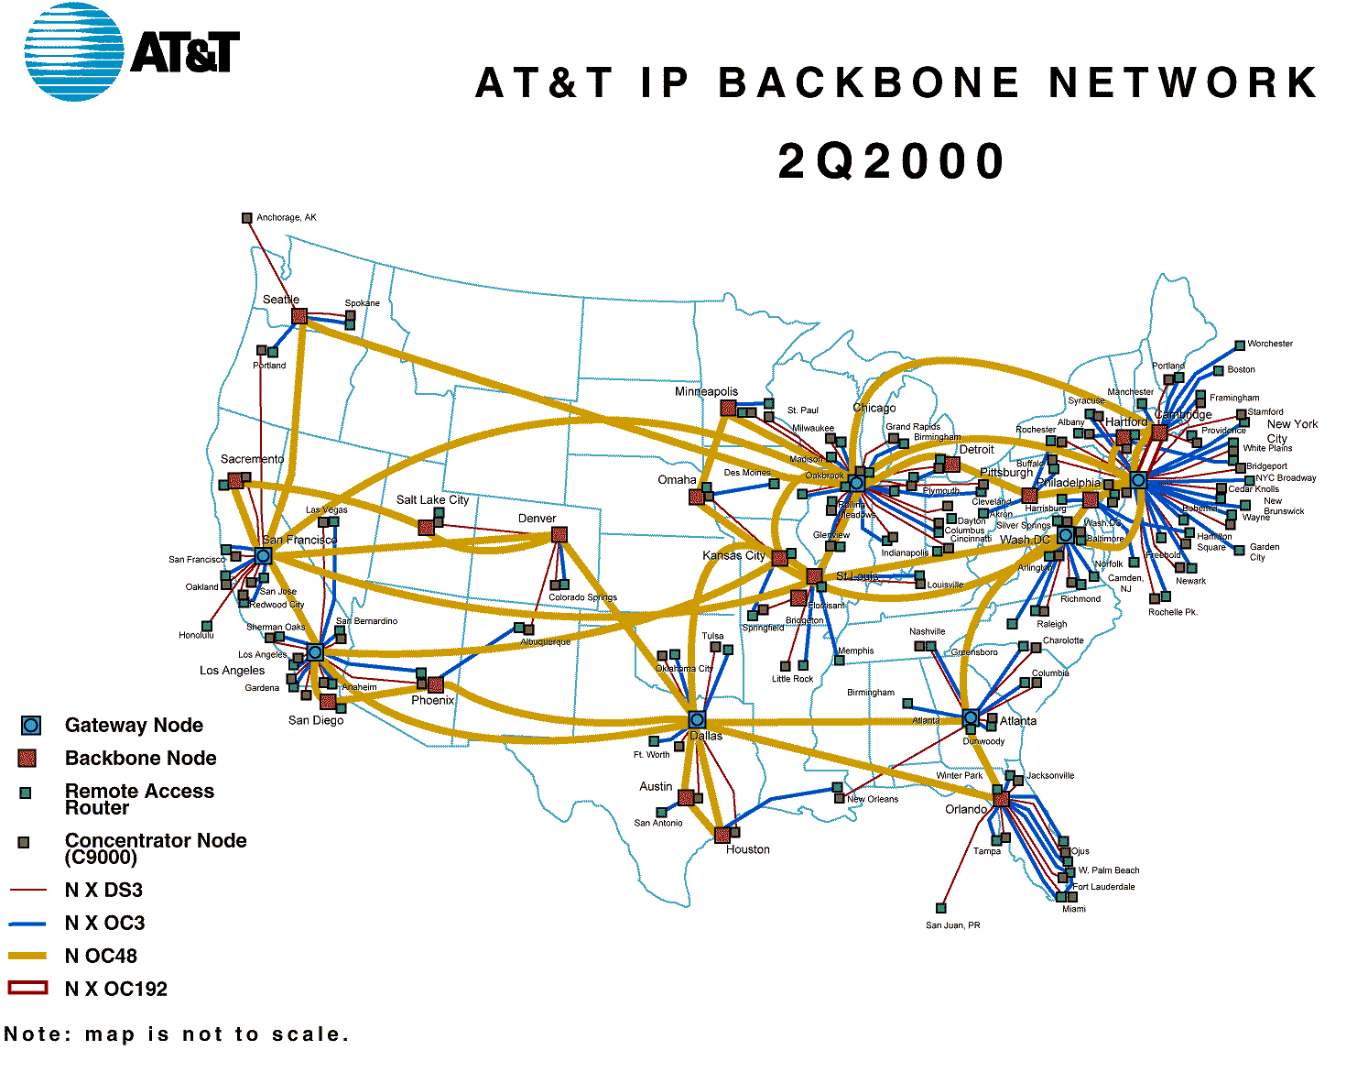
http://www.geog.ucl.ac.uk/casa/martin/atlas/isp_maps.html

Slide 74
Thinking About Speed
Speed can be expressed two ways:
  How long to do something once?
    Memory speed measured as “access time”
  How many things can you do in one second?
    Processor speed measured in “instructions per second”
Convenient units are typically used
  “10 microseconds” rather than “0.00001 seconds”

Slide 75
Some Definitions
Latency
  The amount of time it takes data to travel from source to destination
Bandwidth
  The amount of data that can be transmitted in a fixed amount of time

Slide 76
The Complete Picture
Two parts of moving data from here to there:
  Getting the first bit there
  Getting everything there
Fundamentally, there’s no difference:
  Moving data from the processor to RAM
  Saving a file to disk
  Downloading music from a server in China

