Slide 1
Designing Efficient Cascaded Classifiers: Tradeoff between Accuracy and Cost
Vikas Raykar Balaji Krishnapuram Shipeng Yu
Siemens Healthcare
KDD 2010
TexPoint fonts used in EMF.
Read the TexPoint manual before you delete this box.: AAAAAAAAAA

Slide 2
Features incur a cost
Features are acquired on demand.
A set of features can be acquired as a group.
Each feature group incurs a certain cost.
Acquisition cost can be either
Computational | fast detectors
Financial | expensive medical tests
Human discomfort | biopsy

Slide 3
Example: Survival Prediction for Lung Cancer
2-year survival prediction for lung cancer patients treated with chemo/radiotherapy
 | Feature Group | Number of features | examples | Cost
1 | clinical features | 9 | gender, age | 0 no cost
2 | features before therapy | 8 | lung function creatinine clearance | 1
3 | imaging /treatment features | 7 | gross tumor volume treatment dose | 2
4 | blood bio-markers | 21 | Interleukin-8 Osteopontin | 5 expensive
increasing predictive power … increasing acquisition cost

Slide 4
A cascade of linear classifiers
Stage 1
Stage 2
Stage 3
increasing predictive power
increasing acquisition cost
Training each stage of the cascade
Choosing the thresholds for each stage

Slide 5
Sequential Training of cascades
Conventionally each stage is trained using only examples that pass through all the previous stages.
Training depends on the choice of the thresholds.
For each choice of threshold we have to retrain.
Stage 1
Stage 2
Stage 3

Slide 6
Contributions of this paper
Joint training of all stages of the cascade.
Notion of probabilistic soft cascades
A knob to control the tradeoff between accuracy vs cost
Modeling the expected feature cost
Decoupling the classifier training and threshold selection.
Post-selection of thresholds

Slide 7
Notation
Stage 1
Stage 2
Stage K

Slide 8
Soft Cascade
Probabilistic version of the hard cascade.
An instance is classified as positive if all the K stages predict it as positive.
An instance is classified as negative if at least one of the K classifiers predicts it as negative.

Slide 9
Some properties of soft cascades
Sequential ordering of the cascade is not important.
Order definitely matters during testing.
A device to ease the training process.
We use a maximum a-posteriori (MAP) estimate with Laplace prior on the weights.

Slide 10
Joint cascade training
Once we have a probabilistic cascade we can write the log-likelihood.
We impose a Laplacian prior.
Maximum a-posteriori (MAP) estimate

Slide 11
Accuracy vs Cost
We would like to find the MAP estimate subject to the constraint that the expected cost for a new instance
The expectation is over the unknown test distribution.
Since we do not know the test distribution we estimate this quantity based on the training set.

Slide 12
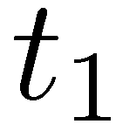
Modeling the expected cost
Stage 1
Stage 2
Stage 3
For a given instance | Cost
Stage 1
Stage 2
Stage 3
We optimize using cyclic coordinate descent

Slide 13
Experiments
Medical Datasets
Personalized medicine
Survival prediction for lung cancer
Tumor response prediction for rectal cancer
Computer aided diagnosis for lung cancer

Slide 14
Survival Prediction for Lung Cancer
2-year survival prediction for advanced non-small cell lung cancer (NSCLC) patients treated with chemo/radiotherapy.
82 patients treated at MAASTO clinic among which 24 survived two years
 | Feature Group | Number of features | examples | Cost
1 | clinical features | 9 | gender, age | 0 no cost
2 | features before therapy | 8 | lung function creatinine clearance | 1
3 | imaging /treatment features | 7 | gross tumor volume treatment dose | 2
4 | blood bio-markers | 21 | Interleukin-8 Osteopontin | 5 expensive

Slide 15
Pathological Complete Response (pCR) Prediction for Rectal Cancer
Predict tumor response after chemo/radiotherapy for locally advanced rectal cancer
78 patients (21 had pCR)
 | Feature Group | Number of features | Cost
1 | Clinical features | 6 | 0
2 | CT/PET scan features before treatment | 2 | 1
3 | CT/PET scan features after treatment | 2 | 10

Slide 16
Methods compared
Single stage classifier
Proposed soft cascade
With beta = 0
Varying beta
Sequential Training
Logistic Regression
AdaBoost [Viola-Jones cascade]
LDA

Slide 17
Evaluation Procedure
70 % for training 30 % for testing
Area under the ROC Curve
Normalized average cost per patient
Using all the features has a cost of 1
Results averages over 10 repetitions
Thresholds for each stage chosen using a two-level hierarchical grid search

Slide 18
Results

Slide 19
Computer aided diagnosis
Motivation here is to reduce the computational cost
196 CT scans with 923 positive candidates and 54455 negative candidates.
Feature Group | Number of features | Average Cost
1 | 9 | 1.07 secs
2 | 23 | 3.10 secs
3 | 25 | 20.7 secs

Slide 20
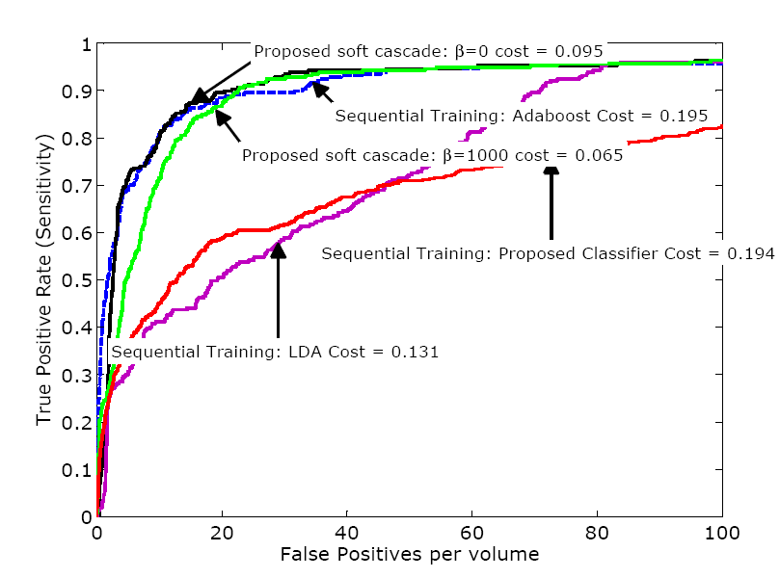
Test set FROC Curves

Slide 21
Conclusions
Joint training of all stages of the cascade.
Notion of probabilistic soft cascades
A knob to control the tradeoff between accuracy vs cost
Modeling the expected feature cost

Slide 22
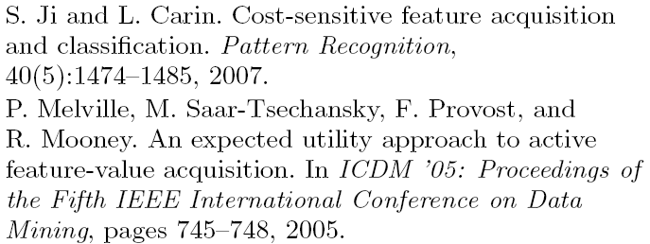
Related work

Slide 23
Some open issues
Order of the cascade
The accuracy vs cost knob is not sensitive in all problem domains

