Slide 1
Social Network Analysis of Personal and Group Networks
Allen Y Tien, Medical Decision Logic
Eric C Jones, Medical Decision Logic
Christopher McCarty, University of Floria

Slide 2
The Plan for Today
Introduction to social networks. (1 hr)
  Why investigate social networks?
  History and definition.
  What exactly are we measuring?
Designing a social network study (goals, design, sampling, bias & name generators issues). (½ hr)
3. EgoNet workshop (1 ½ hrs)
  Introduction to EgoNet screens.
  Collect your own 25-alter ego network.
  Demonstrate visualization interview.
  Demonstrate aggregation and modeling.
4. Research with EgoNet and VisuaLyzer (1 hr)

Slide 3
1. Introduction to Social Networks (i).
Why investigate social networks?

Slide 4
Example of a Research Design in Social and Behavioral Sciences
Age
Education
Income
Height
Weight
Number of cigarettes smoked daily
Independent variables
Dependent variable
A scientist can gather information on a sample of 500 respondents and attempt to predict their smoking behavior using variability across a variety of demographic & biological variables.

Slide 5
Conclusion
Age
Education
Income
Height
Weight
Number of cigarettes smoked daily
Independent variables
Dependent variable
The scientist concludes that age, education and income are good predictors of number of cigarettes smoked daily, but weight and height are not good predictors.

Slide 6
Social Influences
Social scientists think that some outcomes or dependent variables are influenced by social factors.
For example, it is commonly accepted that adolescents start smoking because of their peers.
Since peer influence is not easily observed directly, social scientists design questions that can be used as proxies for peer influence.

Slide 7
Questions (Proxy Measures)
Do your parents smoke? Parents)
Do most of your friends smoke? (Friends)
Have any of your friends ever offered you cigarettes? (Offered)

Slide 8
Predictive Power of Social Influence
Age
Education
Income
Parents
Friends
Offered
Number of cigarettes smoked daily
Independent variables
Dependent variable
Researchers have discovered that these measures expain part of the variance that was previously unexplained by age, education or income.

Slide 9
Questions about These Results
Would knowing more details about the social influences around a person provide greater explanatory power?
If so, what questions could we ask to acquire these details?
Does social network analysis provide the kind of details we’re looking for?

Slide 10
Social influence intervention
National Cancer Institute funded 15 year, $15 million study
40 school districts, 20 experimental, 20 control
Schools spanned grades 3 to 12
Endpoints were daily smoking at grade 12 and 2 years after high school
n = 8,388 students

Slide 11
Intervention
Skills for identifying social influences
Skills for resisting social influences
Information for correcting erroneous perceptions
Motivation to want to be smoke free
Promoting self confidence
Enlisting family support

Slide 12
Results of intervention
Differences in daily smoking at grade 12 between the control and experimental group was not statistically significant
Differences by gender were not significant
Differences between the two groups 2 years after high school are not statistically significant
Daily smoking prevalence was higher 2 years after high school

Slide 13
Why didn’t this work?
Maybe social influences don’t matter
Social influences matter, but they are impossible to control
Social influences matter, but the intervention was too generic

Slide 14
Factors that make social influence non-generic
Variability in the characteristics of influential people
Variability in the structure of the network of influential people
Variability in the characteristics of structurally important people

Slide 15
1. Introduction to Social Networks (ii).
History and definition

Slide 16
A bit of History …
Moreno’s sociometry
The “Manchester School” (Gluckman, Mitchell)
  personal networks of tribal people in the new cities of the Cooperbelt (also India, Malta, Norway)
  messiness of culture change, mobility, multiculturalism
  social networks as an alternative to Structural-Functionalist Theory

Slide 17
A bit of History …
INSNA & Computers & Interdisciplinarity, NScience
American Sociology (1976)
Graph Theory (e.g. Harary 1963)
Manchester School (1954-1972)
Moreno Sociometry (1934)

Slide 18
For instance …
Gossip network … (Epstein, 1957)

Slide 19
East York … (Wellman, 1999)

Slide 20
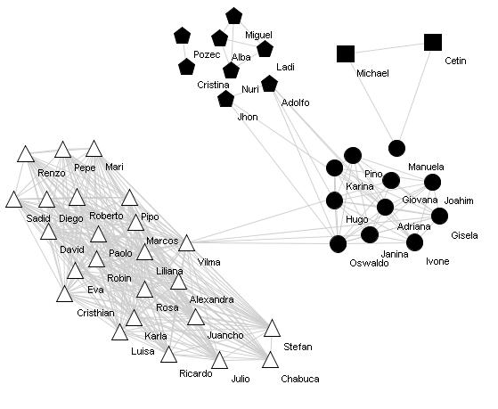
Munich … (2010)
Personal network of a Peruvian migrant in Munich
Perú
Vecindario
Trabajo
Alemania
Familia
Amigos
Notes:
Chris, one student from Javier is studying remittances from Peruvians overseas …

Slide 21
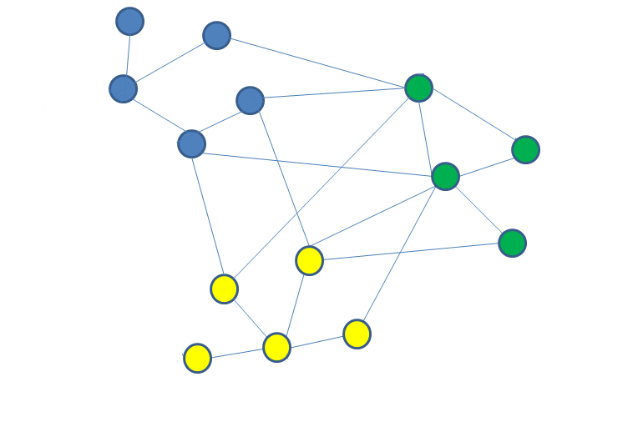
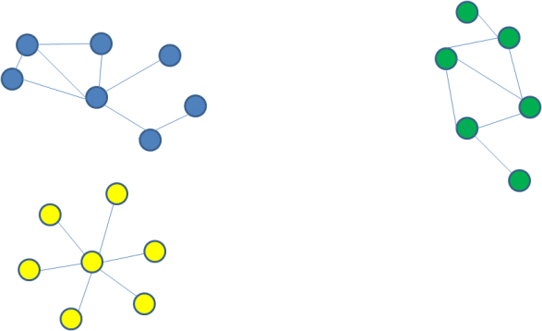
Two kinds of social network analysis
Personal (Egocentric)
Effects of social context on individual attitudes, behaviors and conditions
Collect data from respondent (ego) about interactions with network members (alters) in all social settings.
Whole (Complete or Sociocentric)
Interaction within a socially or geographically bounded group
Collect data from group members about their ties to other group members in a selected social setting.
Notes:
Some nodes are deleted from the whole network of the right because SOME NODES are not captured by the sociocentric networks (for instance, family …).

Slide 22
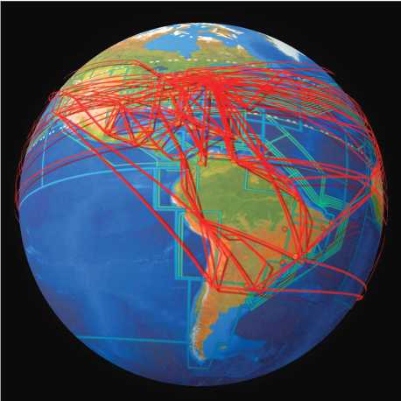
Not a Simple Dichotomy
The world is one large (un-measurable) whole network
Personal and whole networks are part of a spectrum of social observations
Different objectives require different network “lenses”

Slide 23
Personal Networks: Unbounded Social Phenomena
Example: Predict depression among seniors using the cohesiveness of their personal network
Social influence spans social domains
Network variables are treated as attributes of respondents
These are used to predict outcomes
  (or treated as outcomes)

Slide 24
Whole network: Bounded Social Phenomena
Focus on social position within the space
Social or geographic space
Example: Predict depression among seniors using social position in a Retirement Home

Slide 25
Overlapping personal networks: Bounded and Unbounded Social Phenomena
Use overlapping networks as a proxy for whole network structure, and identify mutually shared peripheral alters
Social or geographic space
Example: Predict depression among seniors based on social position within a Retirement Home and contacts with alters outside the home

Slide 26
A note on the term “Egocentric”
Egocentric means “focused on Ego”.
You can do an egocentric analysis within a whole network
  See much of Ron Burt’s work on structural holes
  See the Ego Networks option in Ucinet
Personal networks are egocentric networks within the whole network of the World (but not within a typical, theoretically bounded whole network).

Slide 27
Summary so far
When to use social networks
  If the phenomenon appears to have social influences whose mechanisms are not well understood
When to use whole networks
  If the phenomenon of interest occurs within a socially or geographically bounded space.
  If members of the population not independent, tend to interact.
When to use personal networks
  If the phenomena of interest affects people irrespective of a particular bounded space.
  If the members of population are independent of one another.
When to use both
  When members of the population are not independent and tend to interact, but influences from outside may also be important.

Slide 28
1. Introduction to
Social Networks (iii).
What are we measuring?

Slide 29

Social networks are unique
No two networks are exactly alike
Social contexts may share attributes, but combinations of attributes and ties make each one different
We assume that differences across respondents influence attitudes, behaviors and conditions

Slide 30
Content and shape of a social network may be influenced by many variables
Ascribed characteristics
  Sex
  Age
  Race
  Place of birth
  Family ties
  Genetic attributes
Chosen characteristics
  Income
  Occupation
  Hobbies
  Religion
  Location of home
  Amount of travel

Slide 31
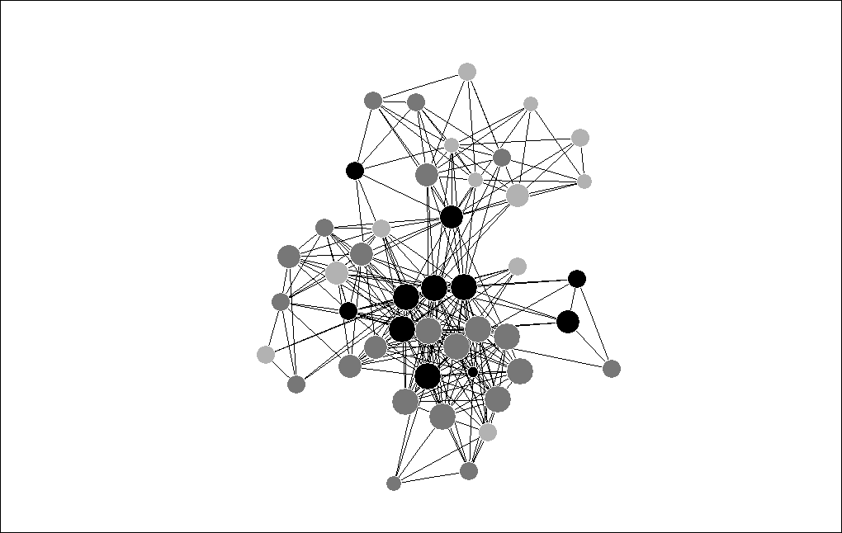
How a whole network is formed
Formal responsibilities
Ascribed characteristics (e.g.,sex) and chosen characteristics (e.g., hobby) may interact with culture to effectively screen potential alters
Ascribed characteristics may influence chosen characteristics, but not the reverse

Slide 32
How a personal network is formed
Social responsibilities
Ascribed characteristics (e.g.,sex) and chosen characteristics (e.g., hobby) may interact with culture to effectively screen potential alters
Ascribed characteristics may influence chosen characteristics, but not the reverse

Slide 33
Types of social network data
Composition: Variables that summarize the attributes of people in a network.
  Proportion with a given responsibility.
  Proportion who are women.
  Proportion that provide emotional support.
Structure: Metrics that summarize structure.
  Number of components.
  Betweenness centralization.
  Subgroups.
Composition and Structure: Variables that capture both.
  Sobriety of most between alter.
  Is person with highest degree & betweenness the same?

Slide 34
Personal Network Composition
Attribute summary file
Name | Closeness | Relation | Sex | Age | Race | Where Live | Year_Met
Joydip_K | 5 | 14 | 1 | 25 | 1 | 1 | 1994
Shikha_K | 4 | 12 | 0 | 34 | 1 | 1 | 2001
Candice_A | 5 | 2 | 0 | 24 | 3 | 2 | 1990
Brian_N | 2 | 3 | 1 | 23 | 3 | 2 | 2001
Barbara_A | 3 | 3 | 0 | 42 | 3 | 1 | 1991
Matthew_A | 2 | 3 | 1 | 20 | 3 | 2 | 1991
Kavita_G | 2 | 3 | 0 | 22 | 1 | 3 | 1991
Ketki_G | 3 | 3 | 0 | 54 | 1 | 1 | 1991
Kiran_G | 1 | 3 | 1 | 23 | 1 | 1 | 1991
Kristin_K | 4 | 2 | 0 | 24 | 3 | 1 | 1986
Keith_K | 2 | 3 | 1 | 26 | 3 | 1 | 1995
Gail_C | 4 | 3 | 0 | 33 | 3 | 1 | 1992
Allison_C | 3 | 3 | 0 | 19 | 3 | 1 | 1992
Vicki_K | 1 | 3 | 0 | 34 | 3 | 1 | 2002
Neha_G | 4 | 2 | 0 | 24 | 1 | 2 | 1990
. | . | . | . | . | . | . | .
. | . | . | . | . | . | . | .
. | . | . | . | . | . | . | .

Slide 35
Social network composition variables
* Proportion of social network that are women …
* Average age of network …
* Proportion of strong ties …
* Average number of years knowing each other …

Slide 36
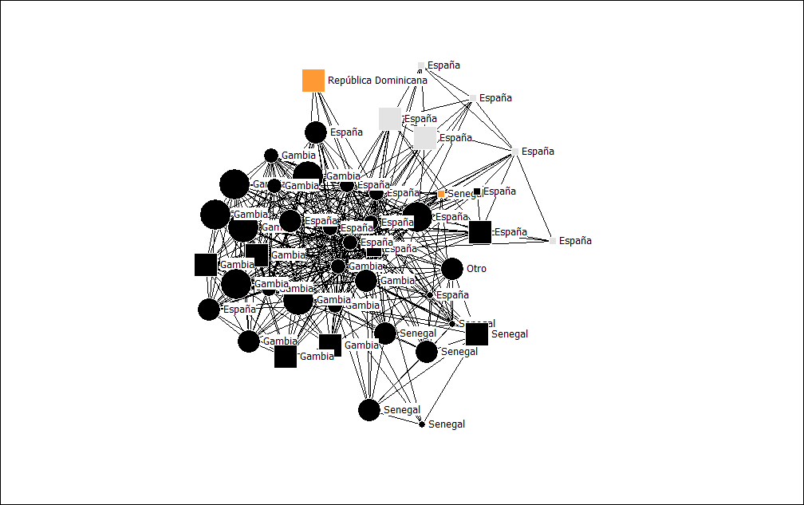
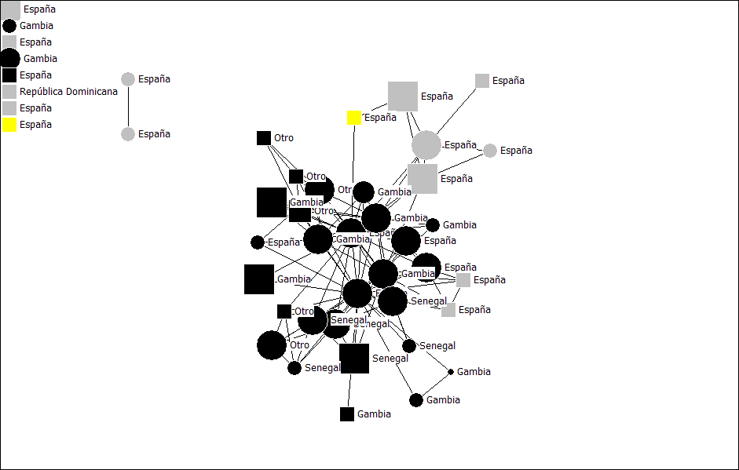
Percent of alters from host country
(personal networks)
36 Percent Host Country
44 Percent Host Country
Percent from host country captures composition
Does not capture structure

Slide 37
Social Network Structure
Adjacency matrix
 | Joydip_K | Shikha_K | Candice_A | Brian_N | Barbara_A | Matthew_A | Kavita_G | Ketki_G | . | .
Joydip_K | 1 | 1 | 1 | 1 | 0 | 0 | 0 | 0 | . | .
Shikha_K | 1 | 1 | 0 | 0 | 0 | 0 | 0 | 0 | . | .
Candice_A | 1 | 0 | 1 | 1 | 1 | 1 | 1 | 1 | . | .
Brian_N | 1 | 0 | 1 | 1 | 1 | 1 | 1 | 1 | . | .
Barbara_A | 0 | 0 | 1 | 1 | 1 | 1 | 0 | 0 | . | .
Matthew_A | 0 | 0 | 1 | 1 | 1 | 1 | 1 | 1 | . | .
Kavita_G | 0 | 0 | 1 | 1 | 0 | 1 | 1 | 1 | . | .
Ketki_G | 0 | 0 | 1 | 1 | 0 | 1 | 1 | 1 | . | .
. | . | . | . | . | . | . | . | . | . | .
. | . | . | . | . | . | . | . | . | . | .
. | . | . | . | . | . | . | . | . | . | .

Slide 38
Social Network Structural Variables
    Average degree centrality (density)
    Average closeness centrality
    Average betweenness centrality
    Core/periphery
    Number of components
    Number of isolates

Slide 39
Components
Components 1
Components 10
Components captures separately maintained groups (network structure)
It does not capture type of groups (network composition)

Slide 40
Average Betweenness Centrality
Average Betweenness 12.7
SD 26.5
Average Betweenness 14.6
SD 40.5
Betweenness centrality captures bridging between groups
It does not capture the types of groups that are bridged

Slide 41
Sociocentric network data collection
Matrix representing ties between network members
Observed data (e-mail transactions, telephone calls, attendance at events)
Ask network members to evaluate tie (Scale of 0 to 5, how well do you know, how close are you)

Slide 42
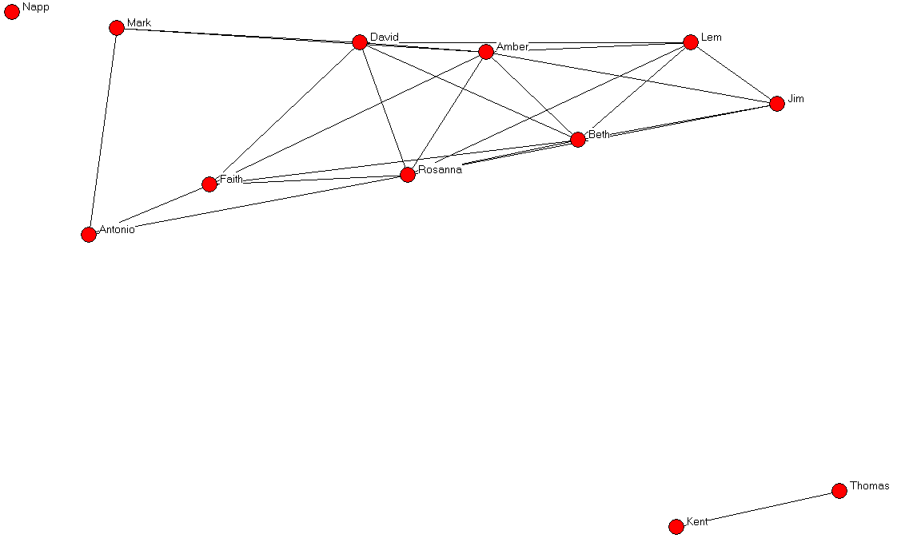

Slide 43
Structural measures
Three network components
Beth is most degree central
Amber is most between central
Thomas and Kent are structurally equivalent
Removal of David maximizes network fragmentation

Slide 44
Some applications of sociocentric network analysis
Structure within organizations
Structure between organizations
Terrorist networks
Diffusion of innovations

Slide 45
Some applications of sociocentric network analysis
Structure within organizations
Structure between organizations
Terrorist networks
Diffusion of innovations

Slide 46
Interventions?
People often have little choice over who is in a whole network
By showing people how the whole network functions, changes can be made to benefit the group
Individuals may use the knowledge of their social position to their advantage
People often have a lot of choice over who is in their personal network (but they may not know it)
Based on ascribed characteristics and chosen characteristics, some people may make conscious choices about the type of people they meet and who they introduce

Slide 47

Many variables of interest to social scientists are thought to be influenced by social context
  Social outcomes
    Personality
    Acculturation
    Well-being
    Social capital
    Social support
  Health outcomes
    Smoking
    Depression
    Fertility
    Obesity

Slide 48
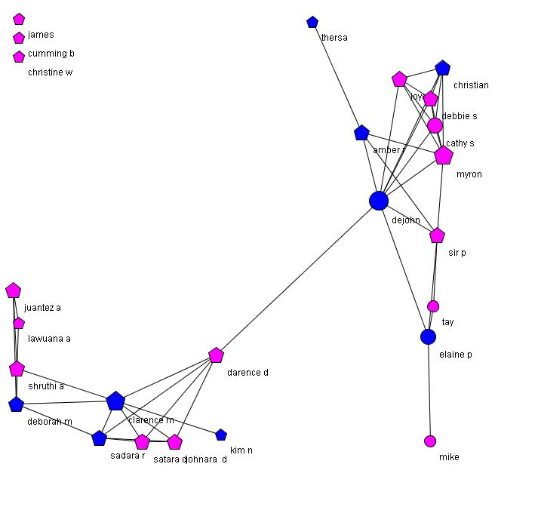
How could we intervene in this network?

Slide 49
2. Designing a
Social Network Study
Goals, design, sampling, bias & name generators issues.

Slide 50
Make sure you need a network study!
Personal network data are time-consuming and difficult to collect with high respondent burden
Sometime network concepts can be represented with proxy questions
  Example: “Do most of your friends smoke?”
By doing a network study you assume that the detailed data will explain some unique portion of variance not accounted for by proxies
It is difficult for proxy questions to capture structural properties of networks

Slide 51
Sometimes the way we think and talk about who we know does not accurately reflect the social context

Slide 52
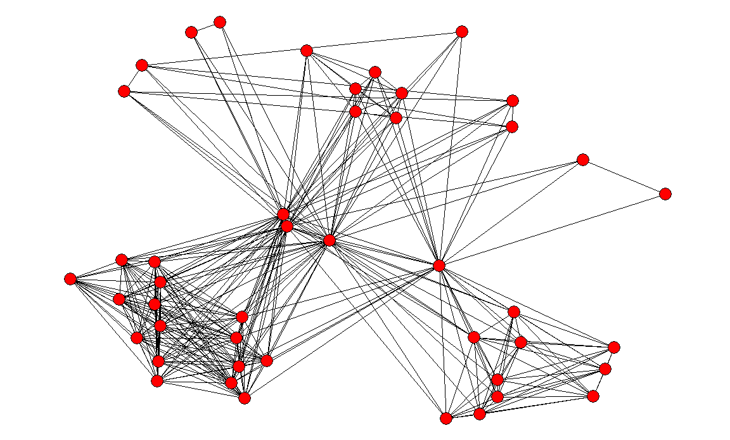
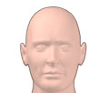
FAMILY
WORK
FRIENDS

Slide 53
Prevalence vs. Relationships
Estimate the prevalence of a personal-network characteristic in a population
  Sampling should be as random and representative as possible.
  Sample size should be selected to achieve an acceptable margin of error.
  Example: Sample 411 personal networks to estimate the proportion of supportive alters with a five percent margin of error.
Analyze the relationship between personal-network characteristic and something you want to predict?
  Sampling should maximize the range of values across variables to achieve statistical power.
  Example: Sample 200 personal networks of depressed and 200 of not depressed seniors to test whether the number of isolates predicts depression.

Slide 54
Steps to a personal network survey
Part of any survey
  1. Identify a population.
  2. Select a sample of respondents.
  3. Ask questions about respondent.
Unique to personal network survey
  4. Elicit network members (name generator).
  5. Ask questions about each network member (name interpreter).
  6. Ask respondent to evaluate alter-alter ties.
  7. Discover with the informant new insights about her personal network (through visualization + interview).

Slide 55
Selecting a Population
Choose wisely, define properly – this largely will determine your modes of data collection and the sampling frame you will use to select respondents.
Certain populations tend to cluster spatially, or have lists available, while others do not
Race and ethnicity may seem like good clustering parameters, but are increasingly difficult to define.

Slide 56
Modes of Survey Research
Face-to-face, telephone, mail, and Web (listed here in order of decreasing cost)
The majority of costs are not incurred in actually interviewing the respondent, but in finding available and willing respondents
Depending on the population there may be no convenient or practical sample frame for making telephone, mail, or email contact

Slide 57
Sample Frames
This can be thought of as a list representing, as closely as possible, all of the people in the population you wish to study.
The combination of population definition and survey mode suggests the sample frames available.
Sample frames may be census tracts, lists of addresses, membership rosters, or individuals who respond to an advertisement.

Slide 58
Example from acculturation study
GOAL: develop a personal-network measure of acculturation to predict migrant behavior outcomes
CHALLENGE: develop an acculturation measure not dependent on language and/or geography
POPULATION: migrants in the US and Spain
SURVEY MODE: face-to-face computer assisted
SAMPLE FRAME: Miami, NYC, Barcelona; n=535 recruitment via classifieds, flyers, and snowballing

Slide 59
Questions about Ego
These are the dependent (outcome) variables you will predict using network data, or the independent (explanatory) variables you will use to explain network data and for controls
  Dependent
    Depression
    Smoking
    Income
  Independent
    Number of moves in lifetime
    Hobbies
  Controls
    Age
    Sex
Be aware that it is common to find relationships between personal network variables and outcomes that disappear when control variables are introduced

Slide 60
Example models from acculturation study
Prob>|t| for models using average degree centrality
Variable | Health | Depression | Smoking | Children
Average Degree Centrality (density) | 0.2546 | 0.0487 | 0.0026 | 0.1516
Sex (1=Male) | 0.0001 | 0.9235 | 0.0009 | 0.0299
Generation (1=First) | 0.6672 | 0.0230 | 0.0412 | 0.4297
Age | 0.4674 | 0.0051 | 0.0747 | 0.4934
Skin color (1=White) | 0.5495 | 0.7051 | 0.3473 | 0.4874
Marital status (1=Never Married) | 0.0451 | 0.2639 | 0.1571 | 0.0001
Employed (1=No) | 0.3921 | 0.0127 | 0.2389 | 0.2501
Education (1=Secondary) | 0.0001 | 0.0073 | 0.2439 | 0.0004
Legal (1=Yes) | 0.1428 | 0.2537 | 0.1330 | 0.3468
R Square | 0.0732 | 0.0619 | 0.0677 | 0.2543

Slide 61
Writing Questions
Be mindful of levels of measurement and the limitations/advantages each provides (nominal, ordinal, interval and ratio)
Ensure that your questions are valid, brief, and are not double-barreled or leading
You can ensure survey efficiency by utilizing questionnaire authoring software with skip logic

Slide 62
Name generators
Only ego knows who is in his or her network.
Name generators are questions used to elicit alter names.
Elicitation will always be biased because:
  Names are not stored randomly in memory
  Many variables can impact the way names are recalled
  Respondents have varying levels of energy and interest

Slide 63
Variables that might impact how names are recalled
The setting
  Home
  Work
The use of external aids
  Phone
  Address book
  Facebook
  Others sitting nearby
Serial effects to naming
  Alters with similar names
  Alters in groups
Chronology
  Frequency of contact
  Duration

Slide 64
Ways to control (select) bias
Large sample of alters
  Name 45 alters.
Force chronology
  List alters you saw most recently.
  Diary.
Force structure
  Name as many unrelated pairs and isolates.
Force closeness
  Name people you talk to about important matters.
Attempt randomness
  Name people with specific first names.

Slide 65
Limited or unlimited
Many reasons respondents stop listing alters.
  They list all relevant alters.
  Memory.
  Fatigue.
  Motivation.
The number of alters listed is not a good proxy for network size
There are other ways to get network size.
  RSW.
  Network Scale-up Method.
Structural metrics with different numbers of alters requires normalization.
Sometimes is preferable to have respondents do the same amount of work.

Slide 66
Names or initials
Some Human Subjects Review Boards do not like alter names being listed.
  Personal health information.
  Revealing illegal or dangerous activity.
With many alters ego will need a name that they recognize later in the interview.
First and last name is preferable or WilSha for William Shakespeare.

Slide 67
Online relations (Facebook)
Should online relationships count?
Relationships that exist outside should…
An understudied question is the nature of exclusively online relationships relative to offline relationships

Slide 68
Personal Network Peculiarities
Respondents may want to list dead people, long-lost friends, TV characters, or celebrities
They may have compromised memories
You may want to limit alters to people who provide respondents specific kinds of support

Slide 69
Acculturation Example
Our prompt (pretested) for freelisting 45 alters:
“You know them and they know you by sight or by name. You have had some contact with them in the past two years, either in person, by phone, by mail or by e-mail, and you could contact them again if you had to.”
Still, migrants often didn’t understand that alters who didn’t live in the host country could be listed

Slide 70
Other Elicitation Options
You may want to let alters keep listing names to get a network size variable, but it is hard to know why people stop listing alters (fatigue, memory, etc.)
More likely, you will want less alters named, since personal network data collection is very intensive
You can use specialized prompts to more randomly elicit fewer alters or only ask questions about every Nth alter named, but keep in mind that eliciting fewer alters will unintentionally bias your sample

Slide 71
Asking Questions about Alters
(Name Interpreters)
Try to avoid having respondents make uninformed guesses about people they know
Still, some researchers argue it is really the respondents’ perception of their alters that influences their own attitudes and behaviors
Figuring out how well a person knows their alters and the nature of their relationships is the most challenging interpretive activity

Slide 72
How well do you know…
Find out long the respondent has known the alter (duration) as well as their frequency and main mode of contact
Research suggests that tie strength is best assessed using questions about closeness
People tend to be less close to people they do not like, even though they may know a lot about them
Asking how respondents know someone is also helpful – “How did you meet?” (school, work, etc.)

Slide 73
Acculturation Example
  45 alters
  x 13 questions about each
  = 585 total items
Demographics (age, sex, CoO, distance, etc.)
Closeness of respondent/alters relationship (1-5)
How they met (family, work, neighbor, school)
Communication (modes, intimacy, trust )
Do they smoke?

Slide 74
Analyzing Compositional Data
Create a summary of each variable for each respondent, keeping in mind their levels of measurement
Merge the summarized variables onto the respondent-level data to explain characteristics of respondents
Measure the extent to which alter characteristics match the respondent (ego correspondence, homophily)
You can then perform frequencies, cross tabulations, and create dummy variables to be used in regressions

Slide 75
Effect of respondent characteristics on predicting migrants’ smoking
Respondent Characteristic | % Does Not Smoke | % Smoke
Sex***
Male | 67 (200) | 33 (99)
Female | 80 (189) | 20 (47)
Employment**
Full Time | 68 (103) | 32 (49)
Part Time | 85 (87) | 15 (15)
Unemployed | 73 (127) | 27 (47)
Retired | 83 (10) | 17 (2)
Self Employed | 54 (19) | 46 (16)
Seasonal | 72 (43) | 28 (17)
Acculturation
Level 1 | 77 (150) | 23 (45)
Level 2 | 71 (148) | 29 (60)
Level 3 | 69 (72) | 31 (32)
Level 4 | 65 (17) | 35 (9)
Level 5 | 100 (2) | 0 (0)
Individual Attributes: age, sex, employment, etc.

Slide 76
Effect of compositional variables on migrant smoking
Composition Variable | % Does Not Smoke | % Smoke
Proportion of alters with listed tie strength
Level 1 | .12 | .10
Level 2 | .24 | .26
Level 3** | .23 | .27
Level 4 | .18 | .17
Level 5 | .22 | .20
Proportion of alters of listed sex
Male*** | .52 | .57
Female *** | .47 | .42
Proportion of alters that are confidantes
Yes*** | .39 | .47
No*** | .61 | .53
Proportion of alters that are smokers
Yes*** | .19 | .35
No*** | .81 | .65

Slide 77
Asking about Ties Between Alters
This is a time consuming process… however,
If you limit yourself to network composition, you assume the effects of social context on attitudes, behaviors and conditions are more about who occupies a personal network than about how they are structurally arranged around the respondent
Still, keep in mind the exponential nature of your chosen alter sample size…

Slide 78
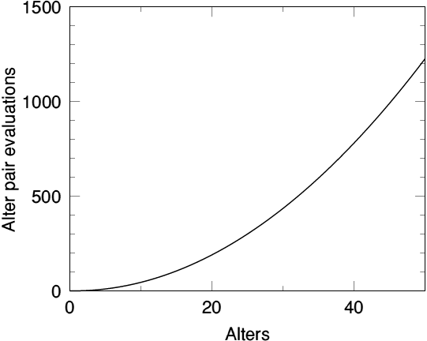
“How likely is it that Alter A and Alter B talk to each other when you are not around? That is, how likely is it that they have a relationship independent of you?”

Slide 79
Questions about Accuracy
Some researchers do not believe respondents can report alter-tie data with any accuracy… We do
It is easier for respondents to report on the existence of ties between alters they know from different social domains than on ties between people they may not know well from a single domain
Personal networks are more attuned to the larger structures of different groups and bridging between groups than subtle interactions within groups

Slide 80
Some Network Structural Procedures
Multi-dimensional scaling is a procedure used to determine the number and type of dimensions in a data set.
Factor Analysis (also called principal components) is a procedure that attempts to construct groups based on the variability of the alter ties. Also used in survey research.
Cluster analysis is a family of statistical procedures designed to group objects of similar kinds into categories.
Quadratic Assignment Procedure is a bootstrap method used to determine whether two networks are different.

Slide 81
Acculturation Example
Network Structural Metric | Does not smoke | Smokes
Average degree centrality*** | 29 | 23
Average closeness centrality | 142 | 149
Average betweenness centrality | 1.5 | 1.7
Components | 1.4 | 1.5
Isolates* | 4 | 6
migrants with denser networks are more likely to smoke
but wait… does smoking cause the structural differences or do the structural differences cause smoking?

Slide 82
Some Network Structural Metrics
Degree Centrality is the number of alters any given alter is directly connected to.
Degree Centralization is the extent to which the network structure is dominated by a single alter in terms of degree.
Closeness Centrality is the inverse of the distance from that alter to all other alters.
Closeness Centralization is the extent to which the network structure is dominated by a single alter in terms of closeness.
Betweenness centrality for a given alter is the number of geodesics (shortest paths) between all alters that the alter is on.
Betweenness Centralization is the extent to which the network structure is dominated by a single alter in terms of betweenness.
Components are connected graphs within a network.
Cliques are maximally complete subgraphs.
Isolates are alters who are not tied to anybody else.

Slide 83
Incremental improvement in R square by adding variable in model with acculturation and control variables
Variable | Health | Depression | Smoking | Children
Strength of tie | 0 | 0.0031 | 0.0018 | 0.0035
Alter sex | 0.0019 | 0.0024 | 0.0012 | 0.0011
Frequency of alter contact | 0.0042 | 0.0169 | 0 | 0.0043
Where alters live | 0.0003 | 0.0072 | 0.0029 | 0.004
Where alters were born | 0 | 0.0005 | 0.0004 | 0.0003
Proportion family | 0.0045 | 0.0019 | 0.0059 | 0.0235
Alter age | 0.0116 | 0.0006 | 0.0025 | 0.0298
Alter race | 0.0012 | 0.001 | 0.0023 | 0.0183
Alter as confidante | 0.0005 | 0.0033 | 0.0267 | 0.0003
Alter smoking status | 0.0001 | 0.0202 | 0.1296 | 0.0046
Average degree centrality | 0.0035 | 0.0065 | 0.0151 | 0.001
Average closeness centrality | 0.0012 | 0.0076 | -0.001 | -0.0002
Average betweenness centrality | 0.0012 | -0.0001 | 0.0021 | 0.0025
Isolates | 0.0033 | 0.0015 | 0.0046 | -0.0003
Components | 0.0051 | 0.0072 | -0.0008 | 0
Core size | 0.0033 | 0.0035 | 0.0095 | 0.0019

Slide 84
Combining Composition and Structure
Treating each variable independently assumes composition and structure do not interact
You can only combine structural variables with compositional variables when they are calculated at the level of the alter…
  Centrality Scores
  Density
  whether or not the alter is an isolate

Slide 85
Acculturation Example
 | Does Not Smoke | Smokes
Proportion of smoking alters that are strong ties | .07 | .13
Proportion of smoking alters that are confidantes | .08 | .18
 | Does Not Smoke | Smokes
Most degree central alter does not smoke | 83 | 57
Most degree central alter smokes | 17 | 43

Slide 86
Personal Network Visualizations
Hand-Drawn vs. Structural

Slide 87
Some Notes on Visualization
Network visualization lets you quickly identify relationships between several compositional and structural variables simultaneously
Visualization should be guided by research question
The way different software algorithms places nodes with respect to one another is meaningful
Nodes and ties can often be sized, shaped, and colored in various ways to convey information

Slide 88
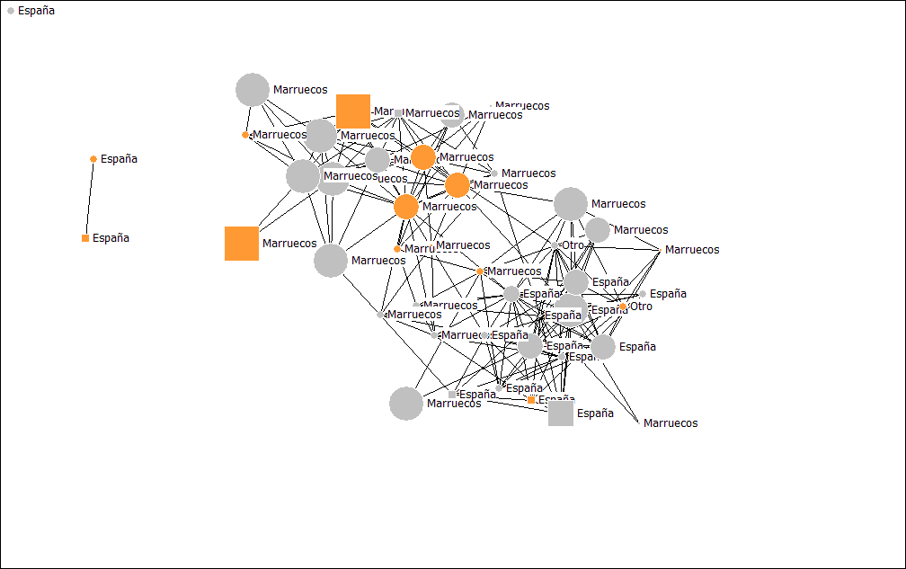
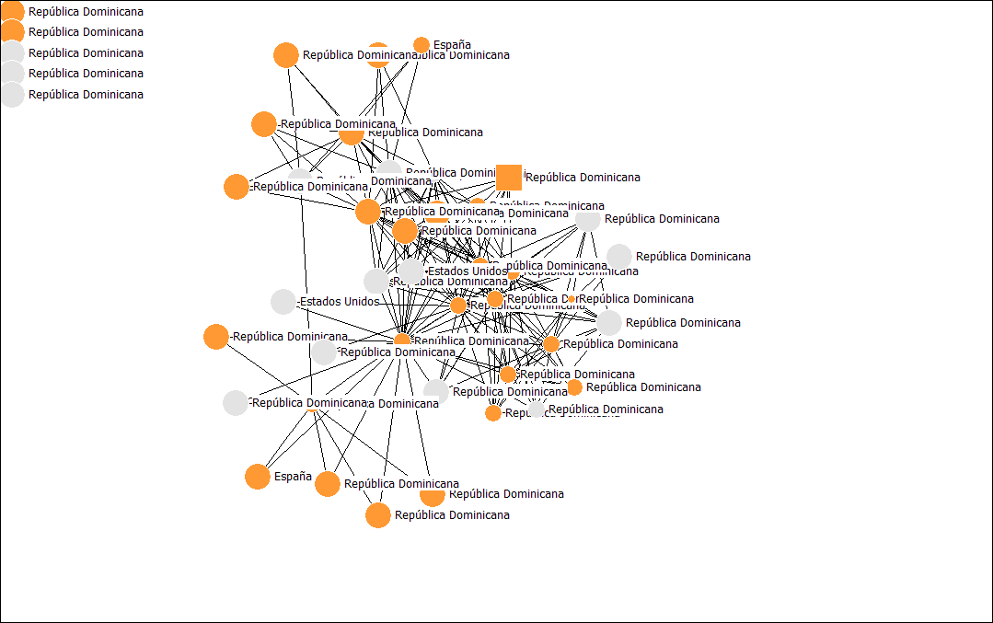
Moroccan migrant in Barcelona – age 36
Dominican migrant in Barcelona – age 46

Slide 89
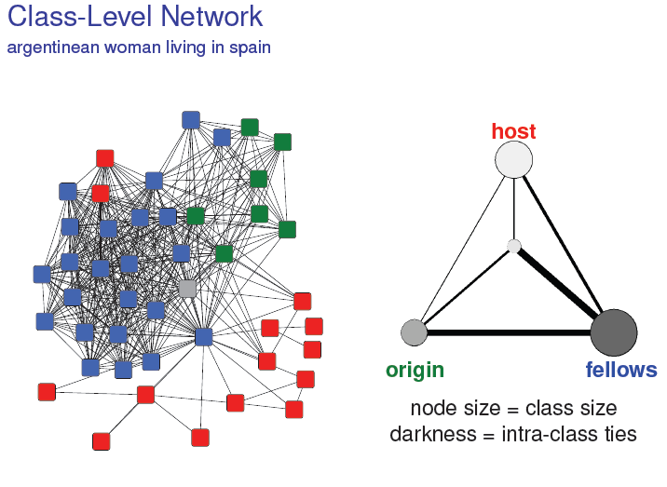
Approach of Juergen Lerner focusing on inter-group ties to create personal network types

Slide 91
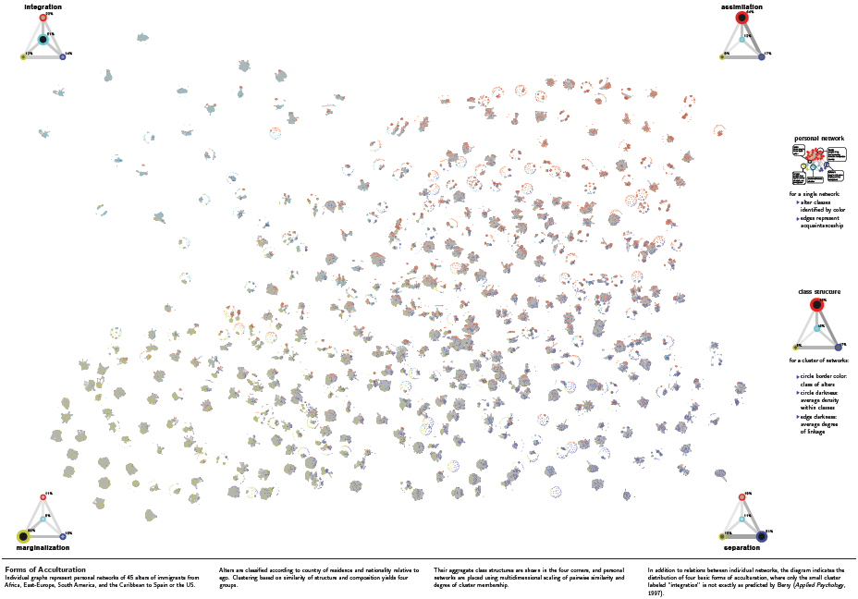

Slide 92
3. Workshop with EgoNet

Slide 93
Egonet
Egonet is a program for the collection and analysis of egocentric network data.
It helps you create the questionnaire, collect data, and provide global network measures and matrices.
It also provides the means to export data that can be used for further analysis by other software.

Slide 94
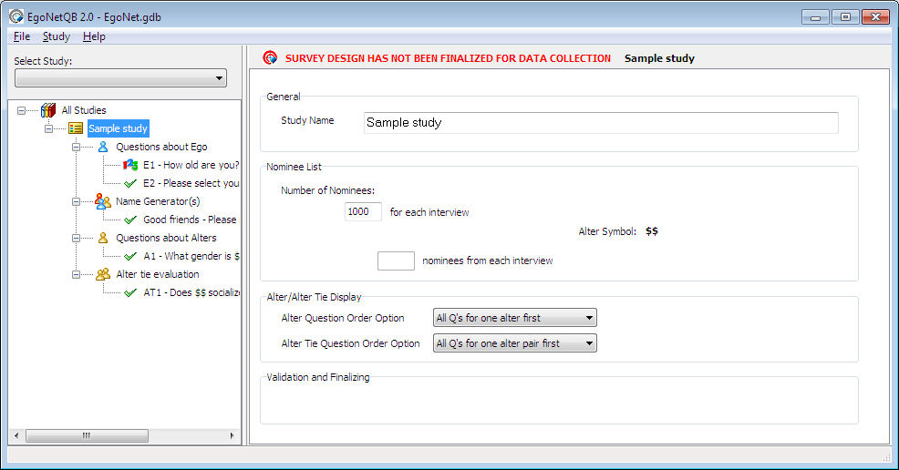
EgonetQB Design Screenshot

Slide 95
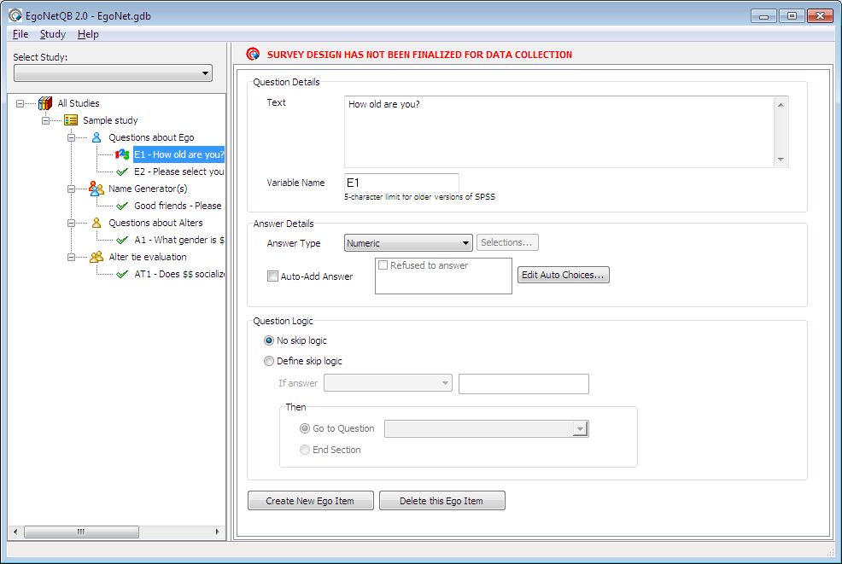
EgonetQB Design Screenshot

Slide 96
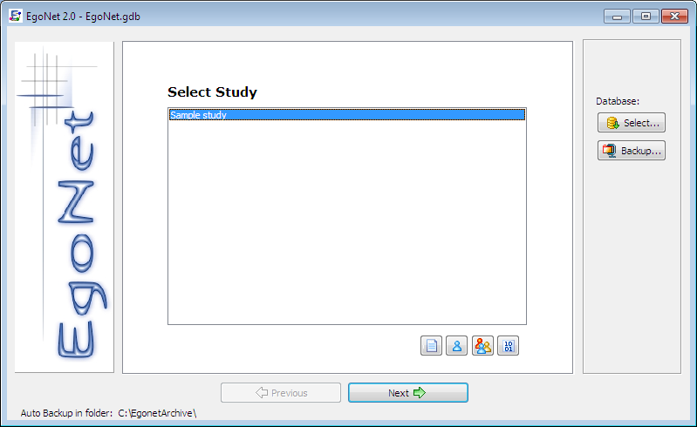
Egonet Design Screenshot

Slide 97
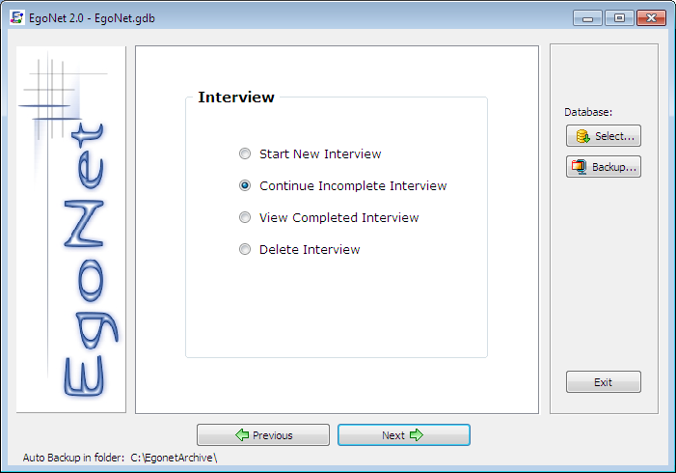
Egonet Design Screenshot

Slide 98
Study design
When you create a new Study, the database
The study design is saved in a file named EgoNet.gdb.
The study has four modules, Ego description, Ego-Alters’ name generator, Alters description and Alter-Alter relationship.

Slide 99
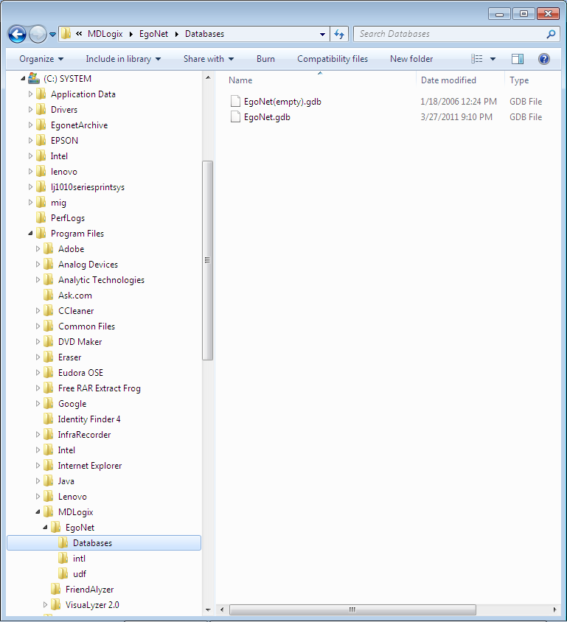

Slide 100
Break!!

Slide 101
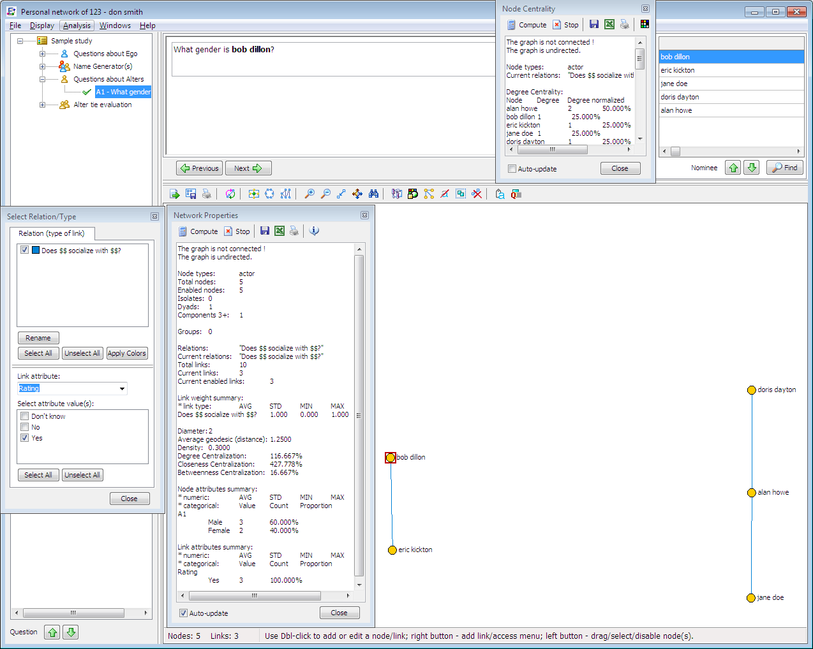
Analysis in Egonet

Slide 102
Two Classmates’ Networks

Slide 103
Analysis in VisuaLyzer

Slide 104
Thanks!

Slide 105
If there is more time

Slide 106
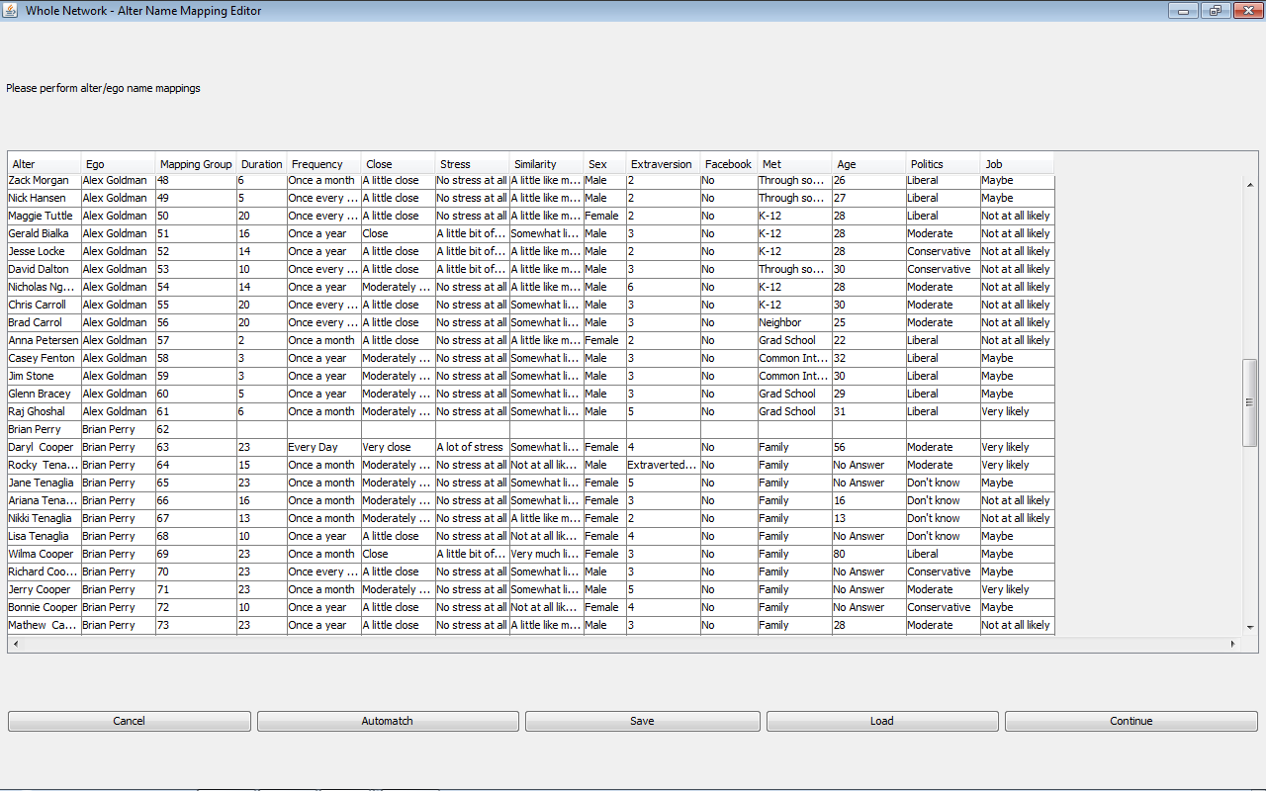
The Automatching Procedure

Slide 107
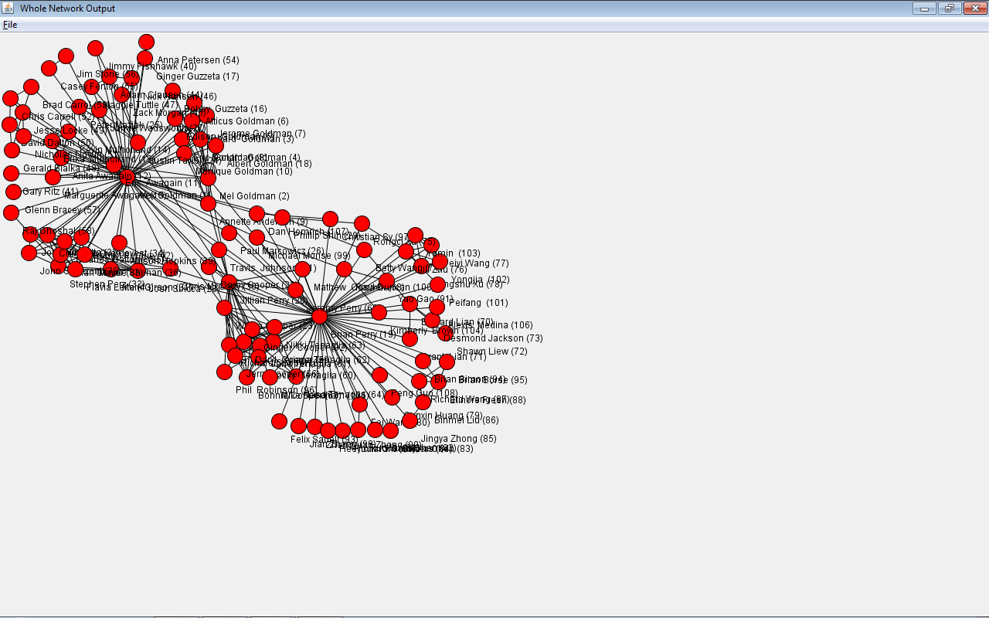
Overlapping Personal Networks

Slide 108
4. Examples from our work

Slide 109
Development of a Social Network Measure of Acculturation and its Application to Immigrant Populations in South Florida and Northeastern Spain
Develop a measure of acculturation based on personal network variables that can be used across geography and language

Slide 110
Visualization of the networks of two sisters
Label = Country of origin, Size = Closeness, Color = Skin color, Shape = Smoking Status
Mercedes is a 19-year-old second generation Gambian woman in Barcelona
She is Muslim and lives with her parents and 8 brothers and sisters
She goes to school, works and stays home caring for her siblings. She does not smoke or drink.
Laura is a 22-year-old second generation Gambian woman in Barcelona
She is Muslim and lives with her parents and 8 brothers and sisters
She works, but does not like to stay home. She smokes and drinks and goes to parties on weekends.

Slide 111
Table 1. Unstandardized means of personal network characteristics per identification (N = 271).
 | Ethnic- exclusive | Ethnic-plural or transna-tional | Generic |  | F
Percentage of French/Wolof Percentage of migrants N cohesive subgroups Homogeneity of subgroups Density Betweenness centralization Average freq. of contact Average closeness Percentage of family | 13.2 29.6 1.6 60.9 41.2 16.2 4.0 2.1 36.3 | 25.2 31.9 2.2 63.5 28.9 20.6 4.3 2.1 30.4 | 26.2 36.3 2.1 56.3 30.6 18.8 4.0 2.1 35.2 |  | 12.3** 2.1 5.2** 1.7 9.5** 3.2* 1.8 0.9 3.1*
* p < .05; ** p < .01.

Slide 112
Social and Cultural Context of Racial Inequalities in Health
Observation: Rates of hypertension are much higher among African Americans than other racial groups
Hypothesis: Hypertension is a function of stress which is caused in part by the compositional and structural properties of the personal networks of African Americans

Slide 113
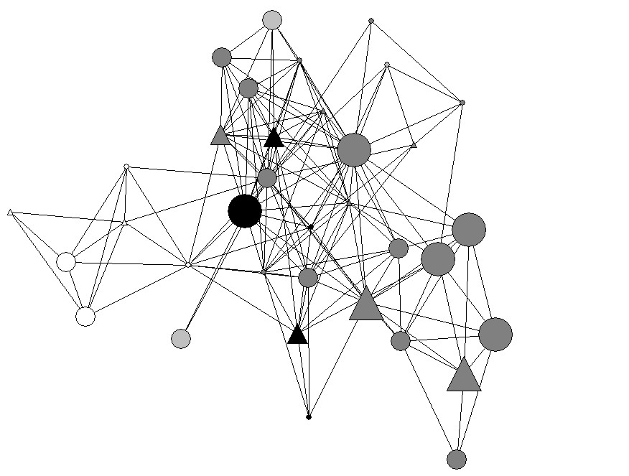
62-year-old African American female with PhD, Income > $100,000, Skin Color=Dark Brown

Slide 114
Egocentric author networks
How does composition and structure of the egocentric co-author network affect scientific impact (the h-index)?

Slide 115
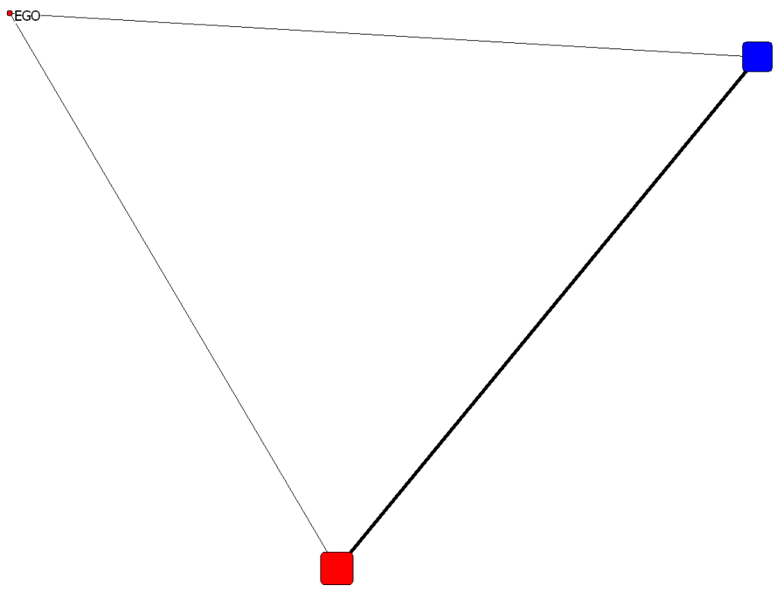
Example 1: Low H, Low co-authors
H-index | 1
# co-authors | 2
Affiliation | Univ Milan, Dipartimento Sci Terra, I-20134 Milan, Italy
Sampled article | Late Paleozoic and Triassic bryozoans from the Tethys Himalaya (N India, Nepal and S Tibet)

Slide 116
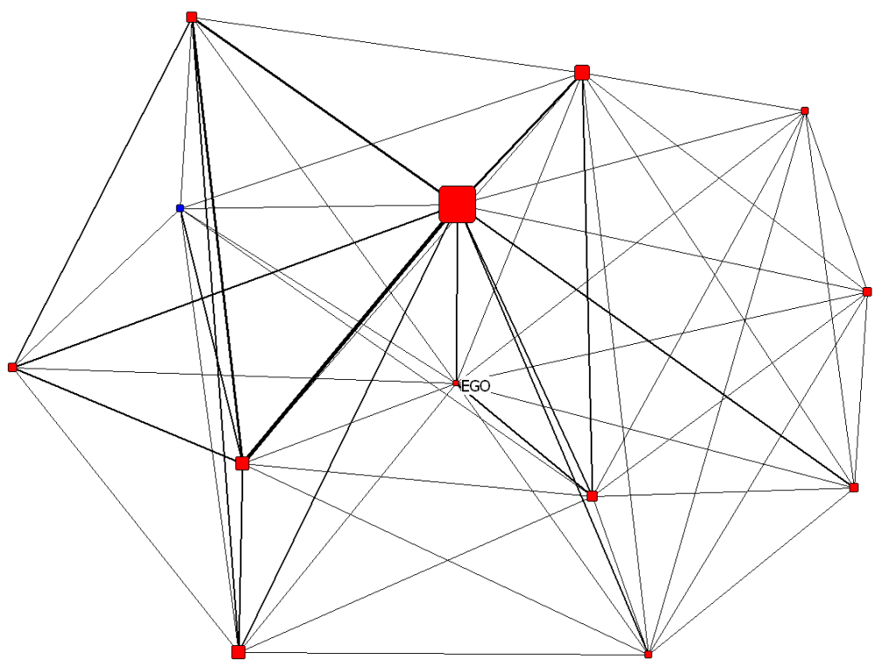
Example 2: Low H, High co-authors
H-index | 1
# co-authors | 12
Affiliation | Clin Humanitas, Med Oncol & Hematol Dept, I-20089 Rozzano, MI, Italy
Sampled article | Chemotherapy with mitomycin c and capecitabine in patients with advanced colorectal cancer pretreated with irinotecan and oxaliplatin

Slide 117
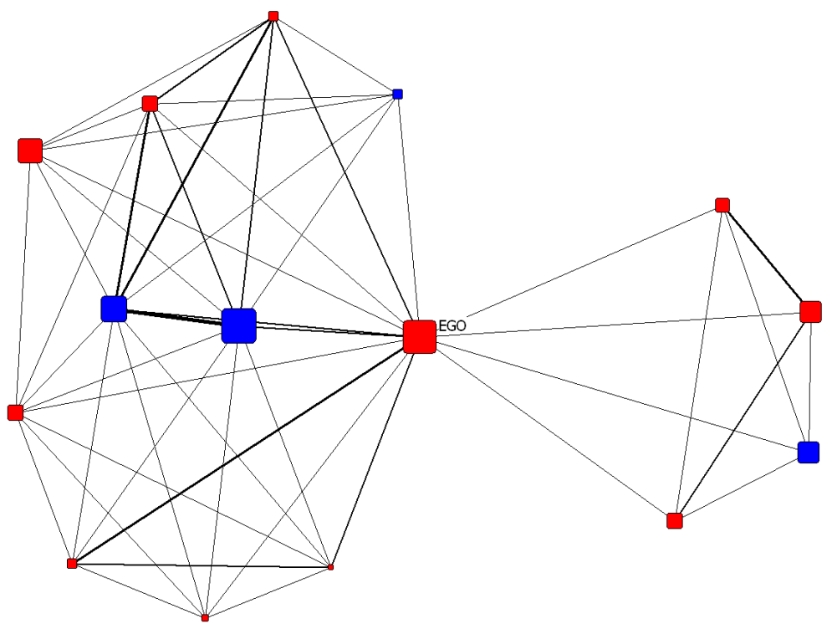
Example 3: High H, Low co-authors
H-index | 31
# co-authors | 14
Affiliation | Catholic Univ Korea, Dept Pharmacol, Seoul, South Korea
Sampled article | Establishment of a 2-D human urinary proteomic map in IgA nephropathy

Slide 118
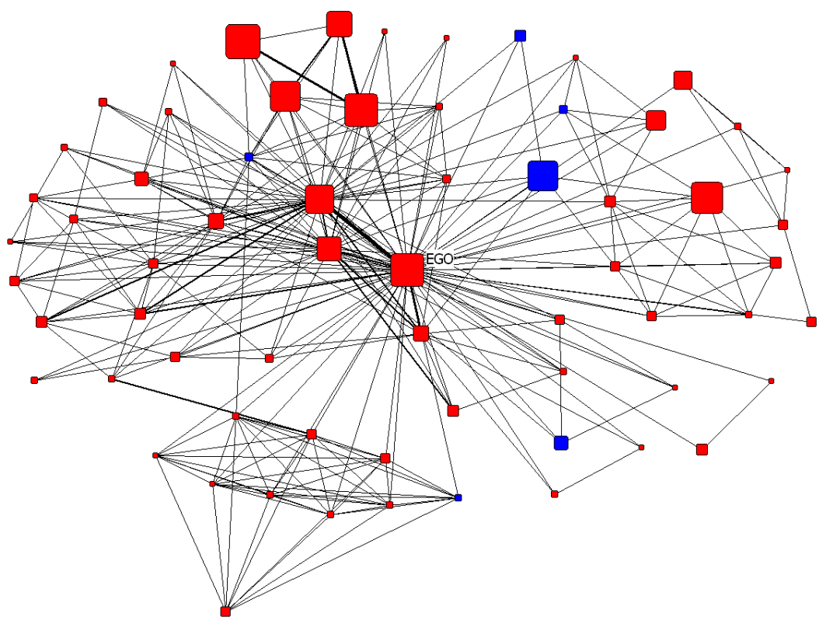
Example 4: High H, High co-authors
H-index | 35
# co-authors | 67
Affiliation | Katholieke Univ Leuven, Oral Imaging Ctr, Fac Med, B-3000 Louvain, Belgium
Sampled article | Development of a novel digital subtraction technique for detecting subtle changes in jawbone density

Slide 119
Analysis
Individual
Aggregated

Slide 120
Promise & Challenges
greater ability to assess causation
greater ability to infer dynamic network change
high likelihood of respondent attrition
more alters may be added to networks over time
Interviewers need to keep asking egos the same questions about their alters – increasing burden

Slide 121
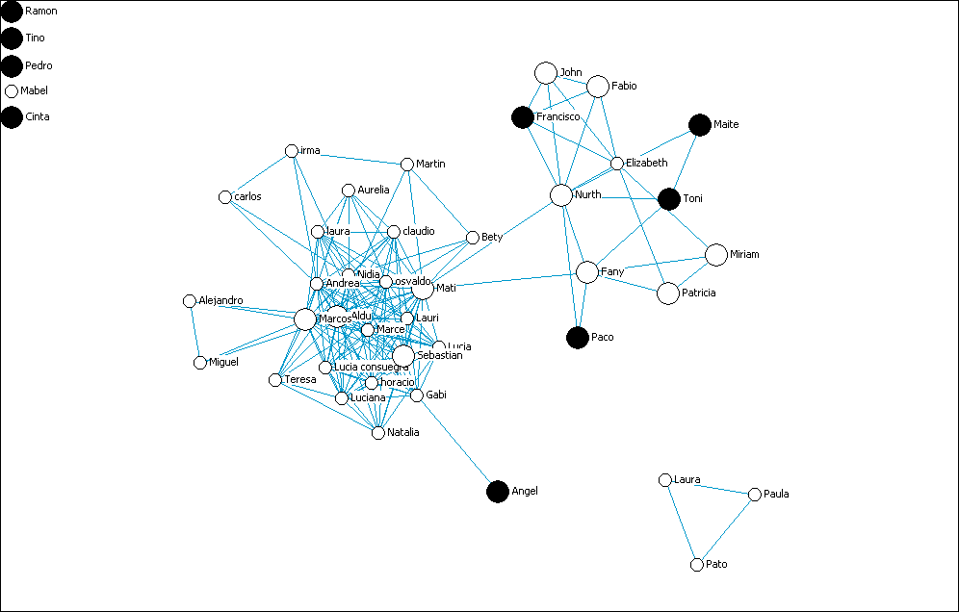
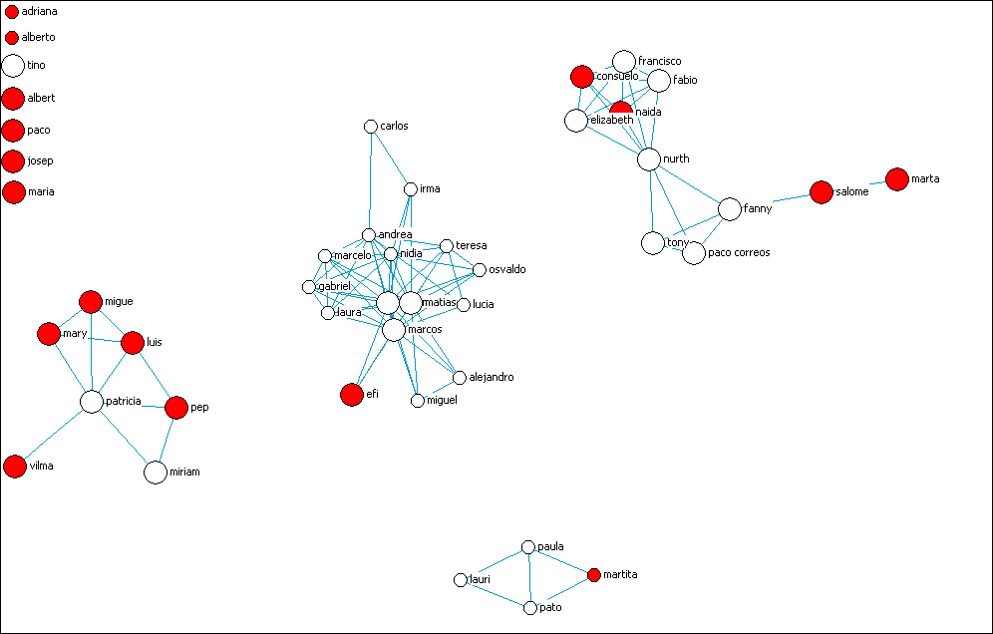
Norma Time 1
Norma Time 2

Slide 122
Personal Network Visualization as a Helpful Interviewing Tool
Many respondents become very interested when they first see their network visualized
By using different visualizations, you can ask respondents questions about their social context that would otherwise be impossible to consider
  why they confide in some alters more than others
  if they’d introduce an alter from one group into another
  Why isolates in their network aren’t tied to anyone

Slide 123
Thanks!

Slide 124
5. Introduction to Vennmaker

Slide 125
Vennmaker
It is a new software tool for participative visualization and analysis of social networks.
Provides a user friendly mapping layout and GUI.
Can compare different individual perspectives and visualizing changes in networks over time.
Allows for automated personal network interviews.
Combines aspects of quantitative and qualitative network analysis in real-time (audio recording).

Slide 126
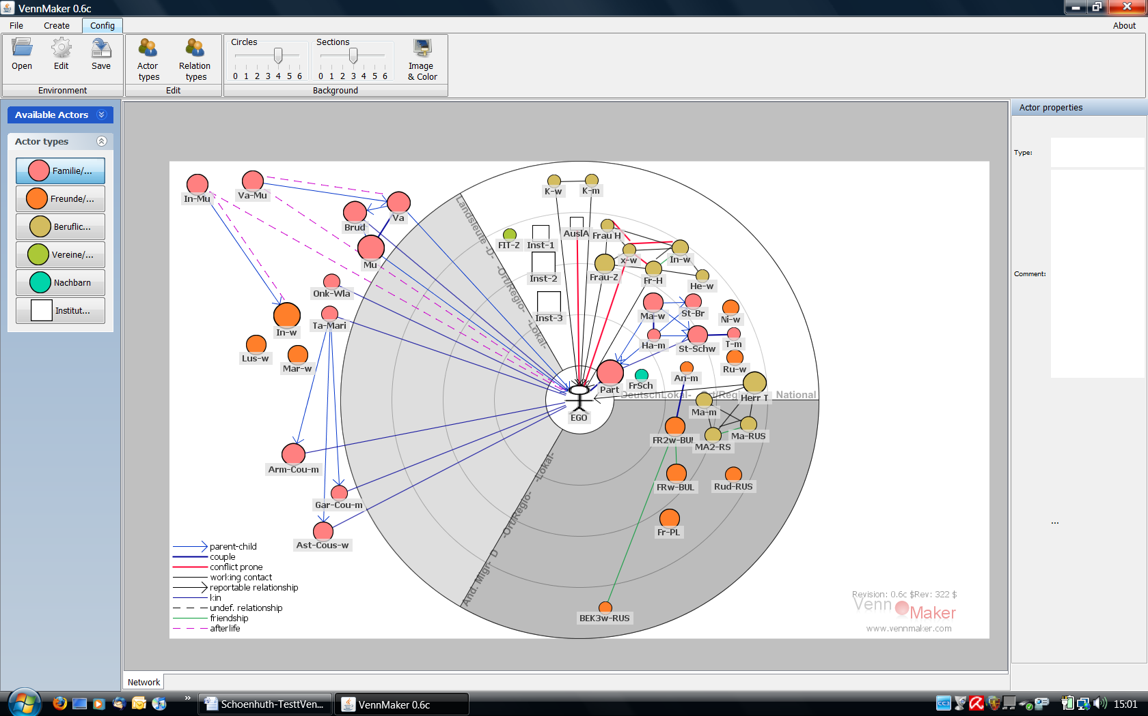

Slide 127
Female 29, single, Caucasus, immigrated 10 years ago
Deceased!
2 „conflicts“
region of origin
2 regions of departure
0 own-ethnic
contacts in GER
Intercultural
working
relationships
region of exit

Slide 128
Final remarks …
In the last decade the studies using the personal network perspective has increased a lot …
Chris McCarty and Jose Molina plan to put all data gathered during the last years in a joint Observatory open to the scientific community:
  http://personal-networks.uab.es

Slide 129
Two-mode personal network

Slide 130
Relation categories in Thailand
Objective: Discover mutually exclusive and exhaustive categories in a language for how people know each other to be used on a network scale-up survey instrument

Slide 131
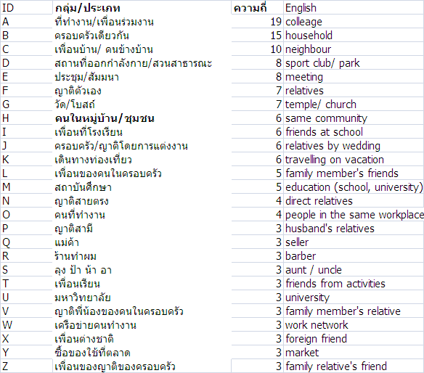
Procedure 1: Twenty one respondents freelist in Thai ways that people know each other

Slide 132
Procedure 2: Twenty one respondents list 30 people they know and apply 26 most frequently occurring categories

Slide 133
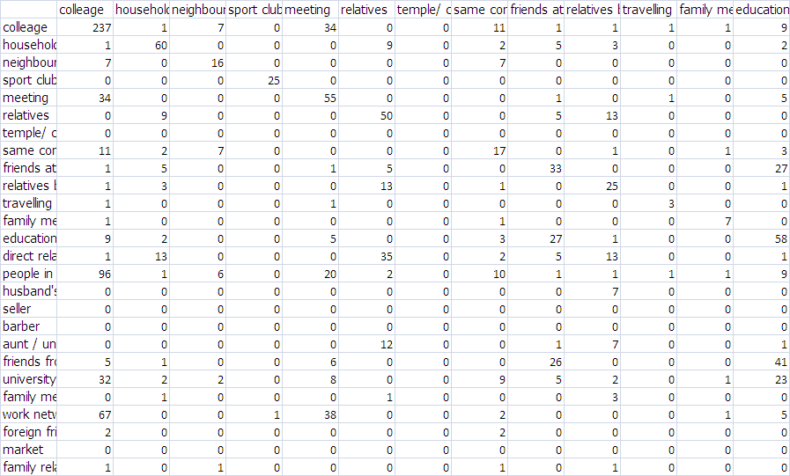
Affiliation from all respondents

Slide 134
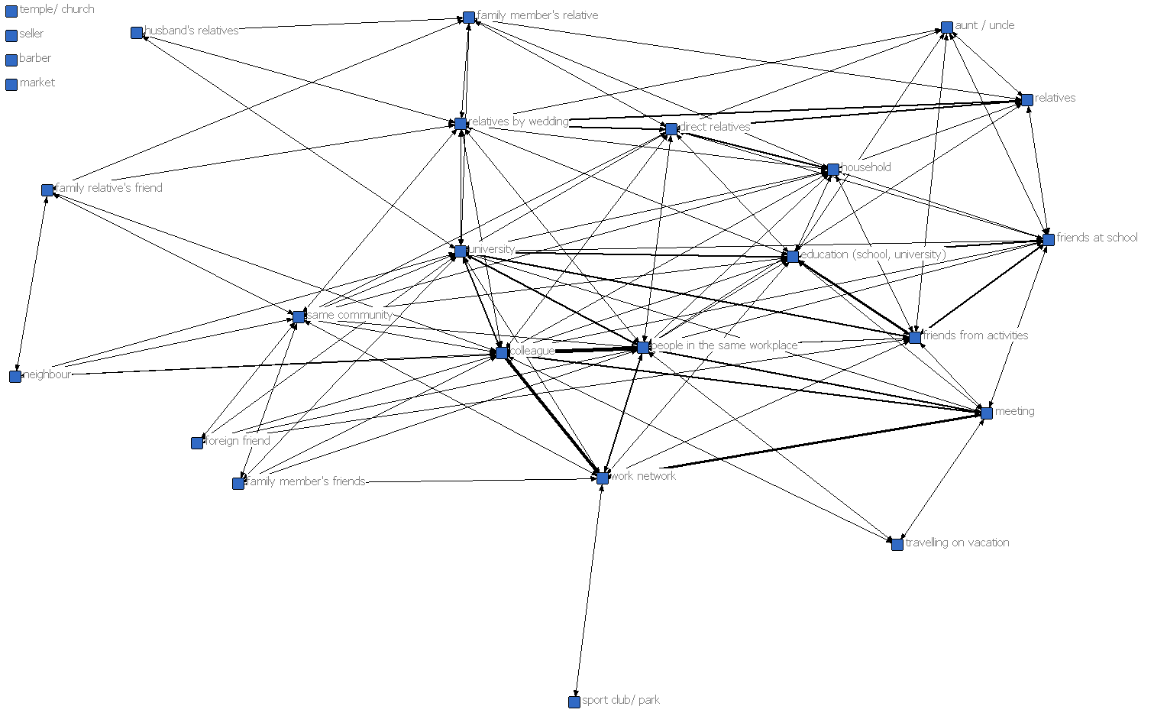
Graph of relationship between knowing categories

Slide 135
Egonet Listserv
Egonet-users mailing list
Egonet-users@lists.sourceforge.net
https://lists.sourceforge.net/lists/listinfo/egonet-users

